Slide 1
Beyond database searching for relevant studies
Le Cleach L, Doney E, Katz KA, Williams HC, Trinquart L.
RTMS: Workflow for Searching Databases to Reduce Evidence Selection Bias in Systematic Reviews.
J Invest Dermatol. 2016 Dec;136 (12):e125-e129.

Slide 2
Reporting Bias is the greatest threat to the validity of systematic reviews
Publication bias:
    25% to 50% of trials are never reported
    Trials with negative results are twice as likely to remain unpublished as those with positive results
Outcome reporting bias:
    Around half of published trials have at least one primary outcome that was changed, introduced, or omitted
    Positive outcomes have increased odds of being reported
Jones CW et al. BMJ 2013; Scherer, R. W. et al. Cochrane Database Syst. Rev. 2007

Slide 3
Consequences of reporting bias
  The results of a systematic review based on a sample of trials not representative of all existing trials will be biased
  Treatment effect estimates for efficacy and safety will be distorted and likely exaggerated
No statistical method allows excluding of reporting bias in systematic review with certainty (Funnel plot )
Dwan, K. et al. PloS One ,2013;Hart, B., Lundh, A. &Bero, L.. BMJ 2012. Kirkham JJ et al. BMJ 2010 Ioannidis JP. J Eval Clin Pract 2008;

Slide 4
FIND THE PUBLISHED TRIALS
Main bibliographical databases
  CENTRAL (Cochrane Central Register of Controlled Trials)
  MEDLINE
  EMBASE
Specialized bibliographical databases for specific topics
Reference lists of included studies
Studies included in previous systematic reviews

Slide 5
FIND THE UNPUBLISHED TRIALS: CONFERENCE ABSTRACT
50% unpublished
No centralized registry
Hand or electronically search
    American Academy of Dermatology,
    Society for Investigative Dermatology,…
    CSG Specialized Register (28 conference proceedings)
Scherer, R.W et al Cochrane Database Syst Rev 2007

Slide 6
FIND THE UNPUBLISHED TRIALS: Clinical trial registries
Aims to overcome reporting bias issue
Databases of planned, ongoing and completed trials
  Trial registration is a legal requirement in the United States, European Union, …, and ICJME requirement for publication
WHO International Clinical Trials Registry Platform Search Portal
  16 data providers (clinicaltrials.gov )
Anderson LM et al. MEJM 2015

Slide 7
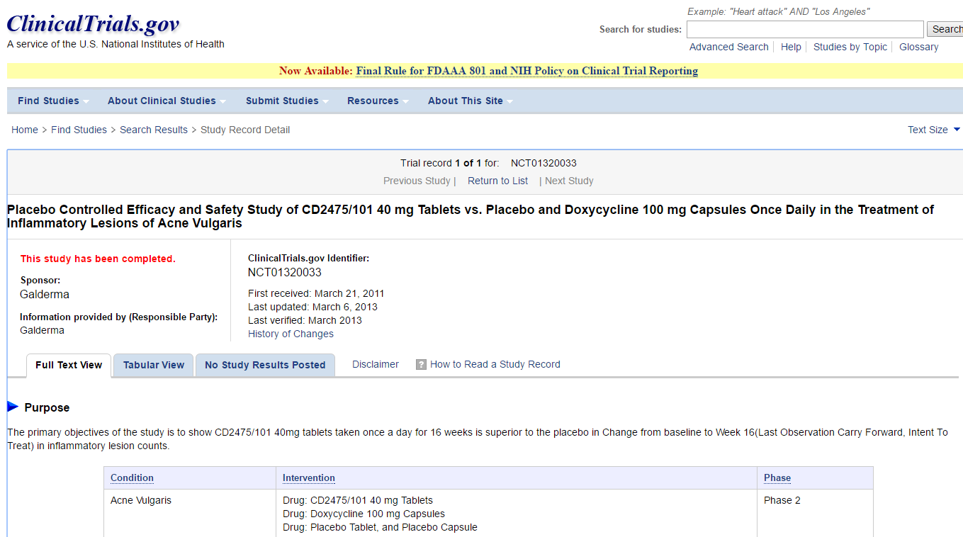
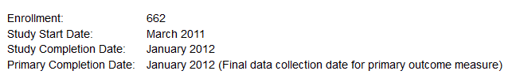
One example:
Contact the trialists or sponsors to inquire about the trial status and results

Slide 8
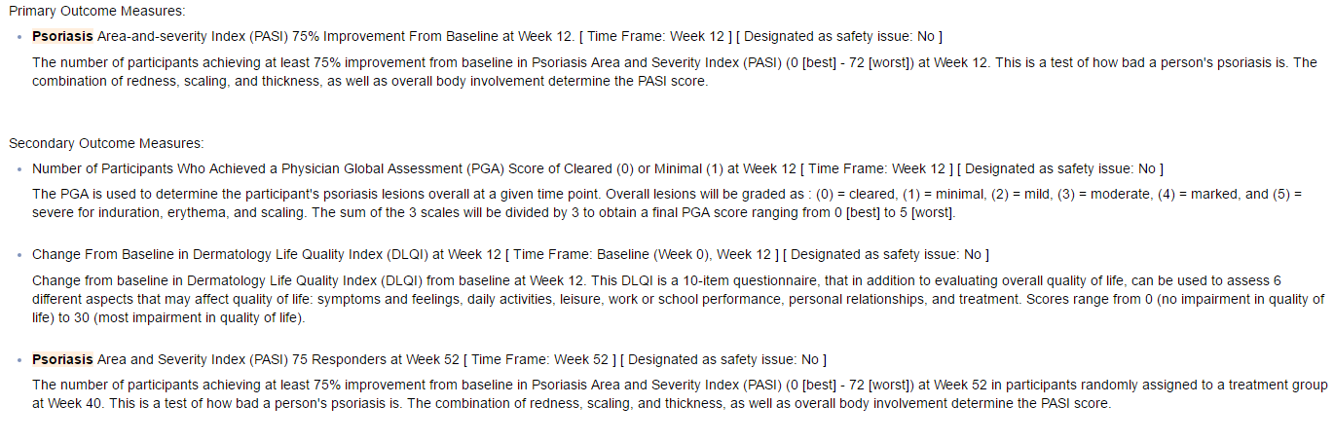
Registries to detect outcome reporting bias
Primary and secondary outcomes are documented in trial record
Compare pre-specified outcomes in the trial record /reported outcomes, in the published article

Slide 9
Clinical trial registries: summary trial data
  FDA in 2009
  The results (for some trials) required to be posted at clinicaltrials.gov within 12 months after completion
  Compliance is far from perfect.
Anderson LM et al. MEJM 2015

Slide 10
Search for unpublished trials: regulatory agency websites
FDA : searchable catalog of approved drug products
EMA : European public assessment reports (EPAR) for every medicine application, (granted or refused a marketing authorization)
Their inclusion can result in modification of the conclusions of MA.
Hart, B., et al. BMJ 2012

Slide 11
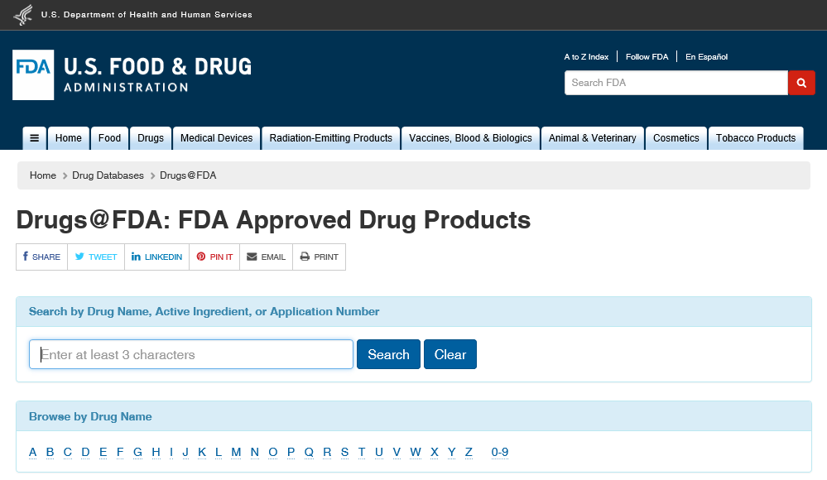
FDA
http://www.accesdata.fda.gov/scripts/cder/daf/

Slide 12
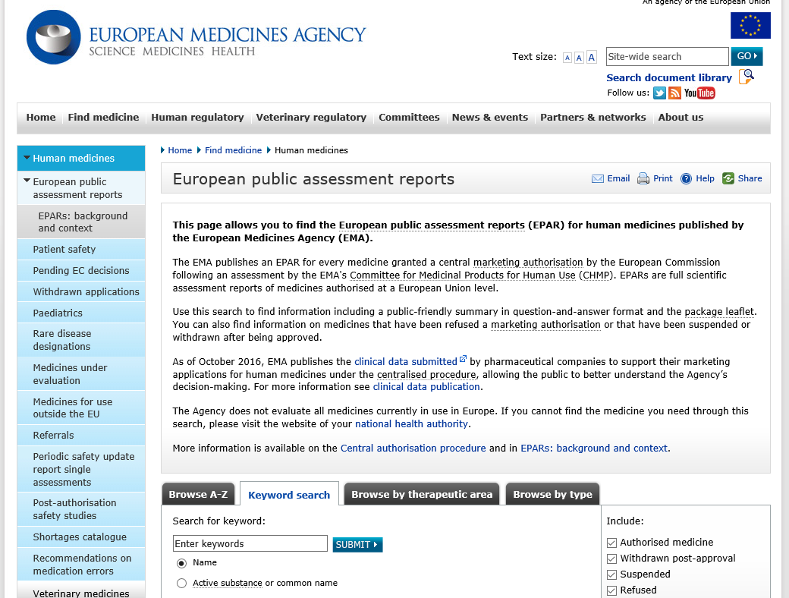
EMA
http://www.ema.europa.eu/ema/index.jsp?curl=pages/medicines/landing/epar_search.jsp

Slide 13
The imiquimod AND molluscum story
Cochrane review in 2009
  1 published RCT: imiquimod vs placebo (23 patients)
  RR 3.67 (95% CI 0.48-28.0) for complete clearance of lesions
FDA’s publicly available review
  3 unpublished trials (827 patients)
  pooled RR 0.93 (95%CI 0.73-1.19)
  Suggesting that imiquimod is ineffective for that indication
van der Wouden et al., 2009. Katz KA, Swetman GL. Pediatrics. 2013

Slide 14
Which primary source information ?
In case of discrepancies for results between different multiple reports for the same trial
  FDA-prepared documents
    Statistical reviewers reanalyze raw data
  Clinicaltrial.gov : AE
  Journal articles
    Possible selective reporting of a subset of statistical analyses
Hartung et al., 2014; Tang E et al.BMC Med. 2015

Slide 15
Future of transparency
http://opentrials.net/
  Aggregate information from a wide variety of existing sources to provide a comprehensive picture of the data and documents on all trials
alltrials.net campaign
  Initiative of organizations such as Cochrane, The BMJ, …calling for registration and reporting of results of all clinical trials.
ICJME
  Proposes to require authors to share with others the individual-patient data as a condition for publication of a clinical trial
Taichman et al., 2016

Slide 16
The clinicalstudydatarequest.com and the Yale University Open Data
  Researchers can request access to individual patient data and supporting documents from industry-sponsored clinicaltrials.
European Medicines Agency
  Guidance on the publication of clinical data for medicinal products 2015 for the publication of clinical reports,
  in a later stage individual patient data.

Slide 17

Challenge
  Not miss data that will change MA results
  But...not be drowned

