Slide 1
Summary of Findings tables in Cochrane reviews
Let’s do it right
Esther van Zuuren
Department of Dermatology
Leiden

Slide 2
Agenda
Introduction (20-25 min)
What is GRADE?
Where can we find information on GRADE
GRADE approach
Rating quality of the evidence
Factors that decrease quality of evidence
Factors that increase quality of evidence
Workshop
Working in two –three groups (40 min)
Discussion within whole group and working all with GRADEproGDT (20-25 min)

Slide 3
What is ?
Grading of Recommendations, Assessment, Development and Evaluation Systematic and explicit approach to making judgements about quality of evidence and strength of recommendations
Quality of evidence rating includes reporting on:
Methodological flaws
Consistency of results
Generalizability
Magnitude of effect
is used by WHO, Cochrane, NICE and >70 other organizations for guideline making

Slide 4
GRADE – getting information
http://www.gradeworkinggroup.org/

Slide 5
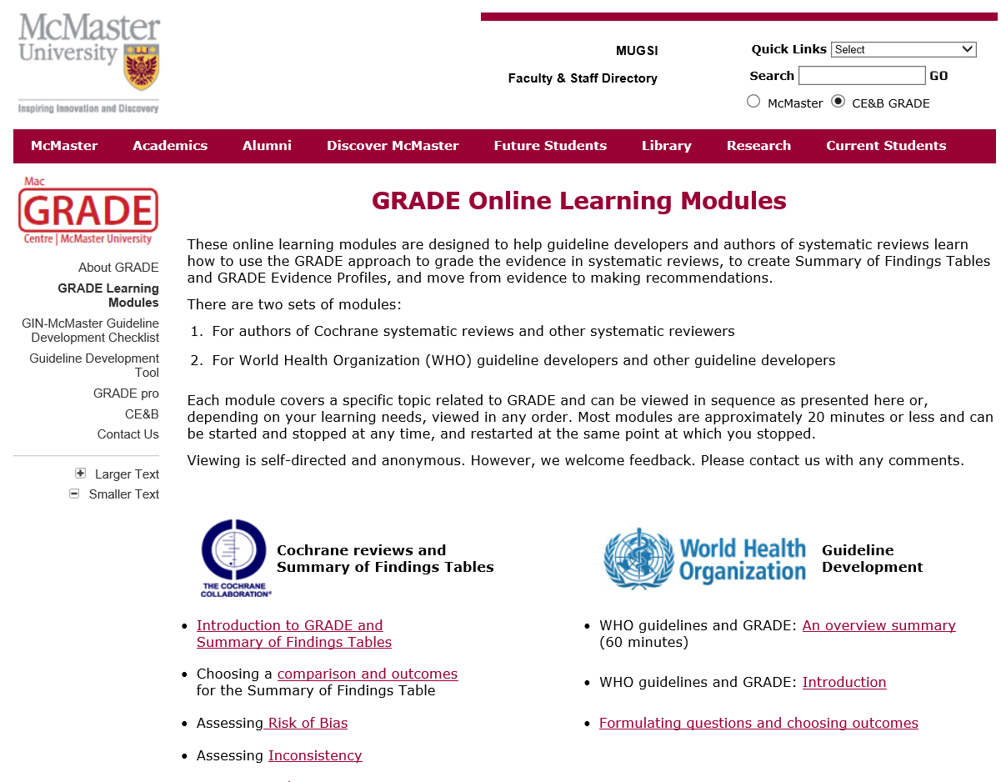
More tutorials and info
http://cebgrade.mcmaster.ca/

Slide 6
What is ?
= ?
= ? ?

Slide 7
GRADE approach
Health Care Question (PICO)
Systematic review
Studies
S1
S2
S3
S4
S5
Outcomes
OC1
OC2
OC3
OC4
Critical outcomes
Important outcomes
Generate an estimate of effect for each outcome
Rate the quality of evidence for each outcome, across studies
RCTs start high, observational studies low
Rating is downgraded: Rating is upgraded:
Study limitations 1. Large magnitude of effect
Imprecision 2. Dose response
Inconsistency of results 3. Confounders likely
Indirectness of evidence minimize the effect
Publication bias likely
Rating of quality for each outcome: high, moderate, low or very low
Notes:
1. Specific question
2. Identify all patient important outcomes
3. Judge relative importance of outcomes
4. Summarize all relevant evidence
5. Grade quality of evidence for each outcome

Slide 8
Rating the quality of evidence
The quality of the evidence reflects the extent of our confidence that the estimates of the effect are correct
High ⊕⊕⊕⊕: true effect lies close to the estimate of the effect
Moderate ⊕⊕⊕O: true effect is likely to be close to the estimate of the effect, but there is a possibility that it is substantially different
Low
⊕⊕OO: true effect may be substantially different from the estimate of effect
Very low ⊕OOO: true effect is likely to be substantially different from the estimate of effect

Slide 9
Factors that lower the quality of evidence
1. Study limitations
2. Inconsistency of results
3. Indirectness of evidence
4. Imprecision
5. Publication bias
If factor is present: downgrade level of evidence by 1 (‘serious’) or 2 levels (‘very serious’)

Slide 10
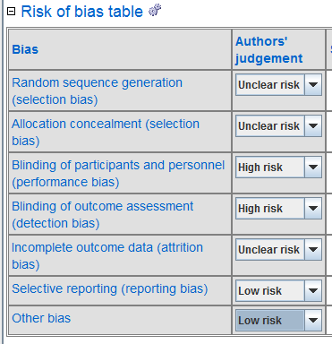
Study limitations
Limitations in design and execution Risk of Bias
Inadequate randomisation
Lack of allocation concealment
Lack of blinding
Large losses to follow-up
Failure to adhere to an ITT analysis
Failure to report outcomes
Other bias (baseline imbalance, co-meds)

Slide 11
How does that look like?

Slide 12
Inconsistency in results
Unexplained heterogeneity of results across studies
1) Clinical heterogeneity may arise from differences in:
Populations
different effect in populations with more disease severity
Interventions
larger effect with higher doses or longer treatment duration
Outcomes
diminishing effect with time (duration in follow-up differ)
2) Methodological heterogeneity (differences in study design or differences in risk of bias)

Slide 13
Inconsistency
Terbinafine versus placebo for tinea cruris and corporis
Look at differences in effect size
Not overlapping of CIs
I²>75%
Notes:
Wide variance of point estimates across studies (note: direction of effect is not a criterion for inconsistency)
Minimal or no overlap of confidence intervals (CI), which suggests variation is more than what one would expect by chance alone
Statistical criteria, including tests of heterogeneity which test the null hypothesis that all studies have the same underlying magnitude of effect, have a low p-value (p <0.05), indicating to reject the null hypothesis

Slide 14
Indirectness
Evidence comes from different research question
Indirect comparison: terbinafine – miconazole
terbinafine – placebo and miconazole – placebo
Population: oral fumaric acid esters for psoriasis
psoriatic arthritis
Comparator: new drug – different dosages isotretinoin
fixed doses of isotretinoin
Outcome: patient satisfaction or aesthetics (treatment varicose)
ultrasound

Slide 15
Imprecision
When are results precise enough?
Consider:
Sample size
-calculation of optimal information size (OIS) http://cebgrade.mcmaster.ca/Imprecision/index.html calculator at http://www.stat.ubc.ca/~rollin/stats/ssize/b2.html Number of events
-rule of thumbs rating down < 300 events in total group Wide confidence intervals
-uncertainty about the magnitude of effect
-CI includes both no effect AND appreciable benefit/harm (RR 0.75/1.25)
Notes:
Wide CI influenced by sample size and nmber of events

Slide 16
Examples of imprecision
CI includes the threshold for appreciable benefit (0.75) and nearly no effect (1.0), very low number of events, low sample size (OIS would be 4238 participants)

Slide 17
Publication bias
Systematic under- or overestimate of the effect due to selective publication of studies
Trials including large numbers of patients are less likely to remain unpublished or ignored and tend to provide more precise estimates of the effect whether positive or negative
Suspicion: evidence is limited to small number of trials, all showing benefit and funded by industry
Check: funnel plot, trial registers, abstract books
Publication bias: ‘undetected’ (no change in quality)
‘strongly suspected’(downgrade by 1 level) ‘very strongly suspected’ (downgrade by 2 levels)
Notes:
Suspicion may increase if visual inspection demonstrates an asymmetrical rather than a symmetrical funnel plot or if statistical tests of asymmetry are positive
An extensive search normally would detect small negative studies publishedin other languages

Slide 18
Rating up the quality of evidence
Large magnitude of effect
Large: RR >2 or RR <0.5 (1 level)
Very large: RR >5 or RR <0.2 (2 levels)
Dose – response relationship
All plausible residual confounding & bias
Would reduce a demonstrated effect
Would suggest a spurious effect if no effect was observed
Mainly applies to observational studies at low risk of bias
Notes:
In another example of this phenomenon, an unpublished
systematic review addressed the effect of condom use on
HIV infection among men who have sex with men. The
pooled effect estimate of RR from the five eligible observational
studies was 0.34 [0.21, 0.54] in favor of condom use
compared with no condom use. Two of these studies
[22,23] that examined the number of partners in those using
condoms and not using condoms found that condom users
were more likely to have more partners (but did not adjust
for this confounding factor in their analyses). Considering
the number of partners would, if anything, strengthen the
effect estimate in favor of condom use. More sexual partners could have diminished the effect

Slide 19
Rating up the quality of evidence
Consideration of factors reducing quality of evidence must precede consideration of reasons for rating it up!
Thus, the 5 factors for rating down quality of evidence (risk of bias, imprecision, inconsistency, indirectness, and publication bias) must be rated prior to the 3 factors for rating it up (large effect, dose-response and effects of residual confounding)
The decision to rate up quality of evidence should only be made when serious limitations in any of the 5 areas reducing the quality of evidence are absent
GRADE Handbook “Although it is theoretically possible to rate up results from randomized control trials, we have yet to find a compelling example of such an instance”

Slide 20
SoF tables in Cochrane reviews
GRADE Handbook: “Systematic reviews that address more than one main comparison (e.g. examining the effects of a number of interventions) will require separate SoF tables for each comparison. Moreover, for each comparison of alternative management strategies, all outcomes should be presented together in one SoF table.”
FUN
=

Slide 21
Workshop
Making groups
3 studies on naftifine for tinea cruris and/or corporis
Fill in the 4 SoF sheets for these 3 studies (divide tasks for RoB and data extraction) MAXIMUM 40 min
Two outcomes: mycological cure and adverse events
-Use per protocol data for mycological cure -Use intention to treat analysis for adverse events
After 40 min: Discussion within the whole group. Everybody works on own laptop with GRADEproGDT (20 mins)
Notes:
We will not work on importance of outcomes

