Slide 1
Interface between Cochrane Skin Group reviews and guidelines
Annual Cochrane Skin Group Meeting, London, 2016

Slide 2
Context
French Satellite of Cochrane Skin Group
French Centre of Evidence Based Dermatology :
Literature update
Guidelines in collaboration with Haute Autorité de Santé (HAS) (French NICE)
First guidelines:
Acne vulgaris
Ongoing or planned :
Hydradenitis suppurativa
Chronic urticaria
Metastatic melanoma
Bacterial skin infections

Slide 3
Guidelines : acne vulgaris Methods
Multidisciplinary group with no conflict of interest
declaration examined and stated by HAS commission
dermatologists, GPs, gynaecologists, endocrinologist, infectiologist, microbiologist, psychiatrist, paediatrician, consumers
HAS librarian
Literature analysis : 4 physicians with methodology Master 2 or PhD

Slide 4
Guidelines : acne vulgaris Literature synthesis and appraisal
References (Update 2007)
Guidelines: 79
Systematic reviews : 53
RCT and observational studies : 520
Selection
133 selected and appraised :
Guidelines : AGREE
Systematic reviews: AMSTAR
RCTs: ROB tool

Slide 5
Complementary therapies for acne vulgaris | 2015
Minocycline for acne vulgaris: efficacy and safety | 2012
Spironolactone versus placebo or in combination with steroids for hirsutism and/or acne | 2009
Combined oral contraceptive pills for treatment of acne | 2012
Topical benzoyl peroxide for acne | Protocol 2014
Topical azelaic acid, salicylic acid, nicotinamide, and sulphur for acne | Protocol 2014
Oral isotretinoin for acne | Protocol 2011
Light therapies for acne | Protocol 2009
Topical antibiotics for acne | Title 2012
Topical retinoids for the treatment of acne vulgaris | Withdrawn
Tobacco smoking cessation for treating acne | Withdrawn

Slide 6
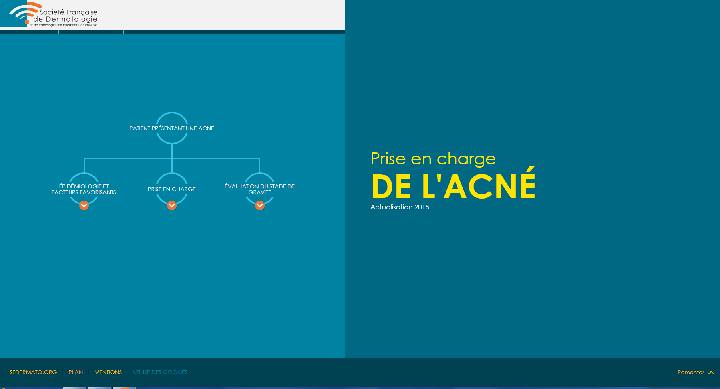
Guidelines : acne vulgaris http://reco.dermato-sfd.org/acne

Slide 7
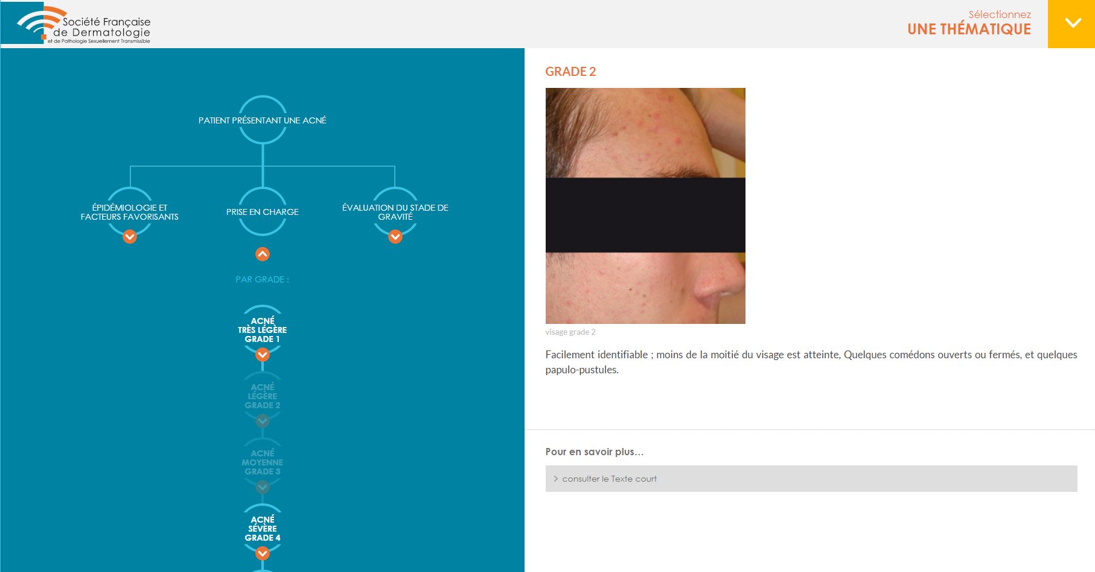

Slide 8
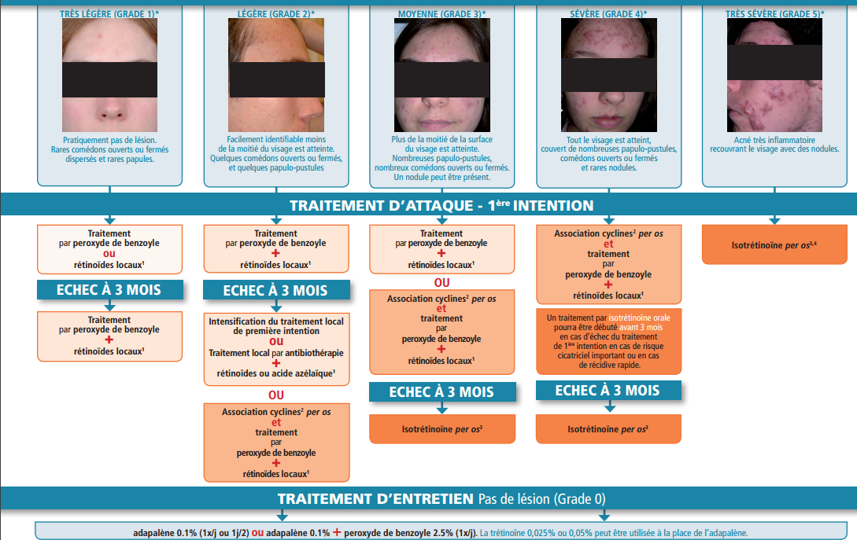

Slide 9
French Centre of Evidence Based Dermatology
How to collaborate to avoid duplication of efforts ?
Theme choice oriented by available Cochrane reviews ?
Hydradenitis suppurativa
Chronic urticaria
Timing choice for actualisation oriented by expected date of Cochrane review publication?
Acne vulgaris

