Slide 1
Common problems with Cochrane skin reviews
  Dr Emma Mead
  Cochrane Skin systematic review methodologist
  16th January 2018, CSG-COUSIN meeting

Slide 2

“Interventions for…” reviews
  Scope is wide – will likely include a large number of interventions
  Multiple outcome measures, multiple timepoints
  Pooling may be challenging
  Summary sections (e.g. abstract) difficult to write
    Important at protocol stage to choose the main comparisons, and to think carefully about your outcomes
  Takes a lot of time and resource – likely needs an update search!

Slide 3
1) Large reviews with multiple comparisons and outcomes
2) Outcomes measured using different instruments/scales
How to deal with:

Slide 4
Large reviews with multiple comparisons and outcomes

Slide 5
Summary sections of the review
Summary of findings (SOF) tables
Abstract
Plain language summary (PLS)
Discussion>summary of main results
In large reviews with multiple comparisons and outcomes, need to prioritise
Word limit on abstract and PLS

Slide 6
Summary of findings (SOF) tables
Protocol stage, decide on main comparisons you will create SOF tables for
Choose up to 7 outcomes (all primary and key secondary)
    Include measure of safety
Other considerations include timepoints and instruments/scales
If these change during the review stage, justify in “Differences between protocol and review” section

Slide 7
Abstract
Word limit so need to prioritise what is reported
Results in your SOF tables
May need to prioritise comparisons further if large number of SOF tables
Don’t have to report all outcomes in the SOF tables – but should report primary outcomes (plus a measure of safety)
Each comparison included in this section needs to report the same outcomes

Slide 8
Plain Language Summary (PLS) and Discussion>Summary of main results
Should reflect what is reported in your abstract
PLS – results reported in plain language
Discussion>summary of main results – narrative description of the results

Slide 9
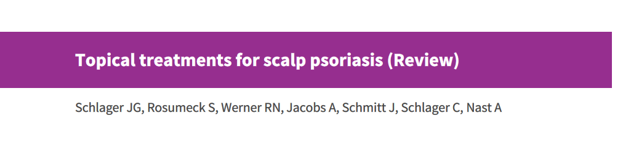
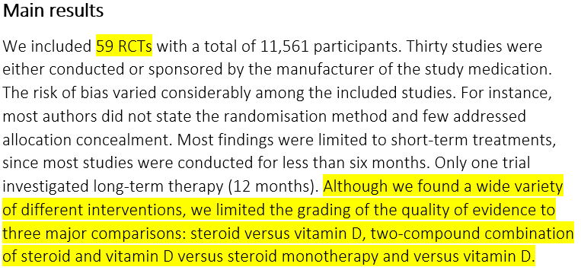

Slide 10
Outcomes measured using different instruments/scales

Slide 11
Protocol stage
Really important to carefully think about the outcomes you select
For each outcome, consider how you will handle multiple timepoints, and outcome measures
    Will you restrict to certain timepoints?
    Will you only consider certain measures of an outcome? Will there be a hierarchy?

Slide 12
How to handle multiple measures of the same outcome?
E.g. quality of life – measured using different scales
Option 1: include all scales (or a large number) and present the results for each scale separately and not pool
    Difficult to summarise
Option 2: restrict to only one or two scales
    May lose a lot of data
Option 3: for continuous data, use the standardised mean difference (SMD)
    Can be quite difficult to interpret

Slide 13

Standardised mean difference (SMD)
For continuous data:
“The standardized mean difference is used as a summary statistic in meta-analysis when the studies all assess the same outcome but measure it in a variety of ways (for example, all studies measure depression but they use different psychometric scales). In this circumstance it is necessary to standardize the results of the studies to a uniform scale before they can be combined. The standardized mean difference expresses the size of the intervention effect in each study relative to the variability observed in that study”
(Cochrane handbook, version 5.1, Chapter 9.2.3.2)

Slide 14

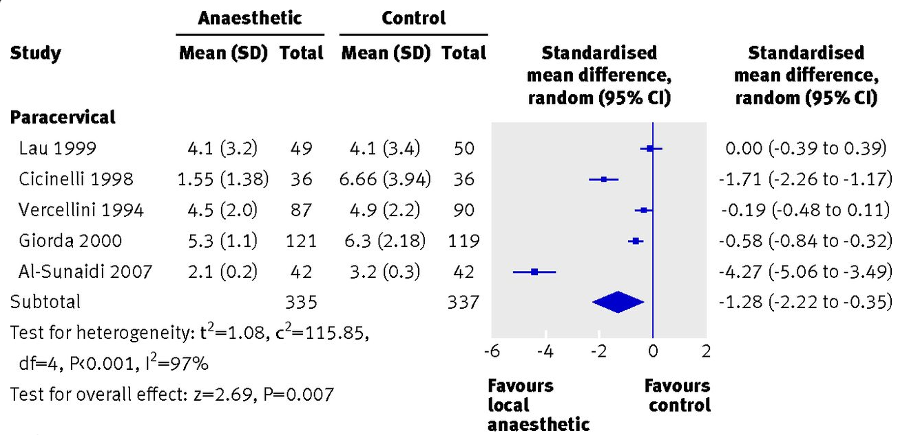
SMD
Pain scores
Remember, if the direction of scales is different you need to multiply the mean values from one set of studies by -1 to ensure the scales all point in the same direction.
Sedgwick, P. and Marston, L., 2013. Meta-analyses: standardised mean differences. BMJ: British Medical Journal (Online), 347

Slide 15
How to interpret SMDs (1)
E.g. SMD -1.28 (95% CI -2.22 to -0.35)
Report as SD units
    Mean score in the intervention group is 1.28 standard deviations lower (2.22 to 0.35 lower) than in the control group
Cohen’s interpretation of SMD effect sizes:
    0.2 = small effect
    0.5 = moderate effect
    0.8 = large effect
      But these interpretations are limited as do not account for the context of the findings

Slide 16
How to interpret SMDs (2)
The SMD can be converted to show the difference on a familiar scale
    Select one study from your SMD meta-analysis using your preferred scale (should be low risk of bias and representative of population and intervention)
    Multiply SMD (and 95% CI limits) by SD from the control group
    This will give the mean difference (95% CI) for the chosen scale
This method can be challenging as it may be difficult to decide which study to use
    Could use a SD from an observational study
    Could use a range of SDs as a sensitivity analysis if concerned about the chosen SD

Slide 17
To summarise
For very broad reviews, important to prioritise the main comparisons and outcomes of interest (at protocol stage)
Also prioritise timepoints and instruments/scales
For continuous outcome measures expressed using different instruments/scales, consider using SMD
Writing the abstract/PLS should be much easier
Other options include doing a network meta-analysis, or do a more targeted review

Slide 18

Any questions

