Slide 1
Multiplicity and Heterogeneity
Emma Mead
Methodologist at the Cochrane Skin Group, University of Nottingham
Research associate and PhD student, Teesside University
Email: Emma.Mead@nottingham.ac.uk
Dr Ben Carter
Statistics Editor for the Cochrane Skin Group,
Hon Associate Prof, University of Nottingham
Senior Lecturer in Biostatistics, King’s College London
Email: ben.carter@kcl.ac.uk

Slide 2
What is multiplicity
“The more analyses that are done, the more likely it is that some of them will be found to be ‘statistically significant’ by chance alone”
16.7 Multiplicity in systematic reviews

Slide 3
What is the problem of multiple testing
1) Too many hypothesis tests, thus increased chance of a false positive
“For instance, after 14 independent significance tests, the probability is more than 50% that at least one test will be significant“
2) How to interpret mixed findings
7 hypothesis tests favoured intervention A
4 hypothesis tests favoured intervention B
3 hypothesis tests favoured neither
Is treatment A or B most beneficial ?

Slide 4
What is a primary outcome?
“Primary outcomes are the two or three outcomes from the review would be likely to be able to address in order to reach a conclusion about the effects (beneficial and adverse) of the intervention(s).”
Chapter 5 : Defining the review question and developing criteria for including studies
In other words
Primary outcome hypothesis tests determine if intervention A is better than intervention B.

Slide 5
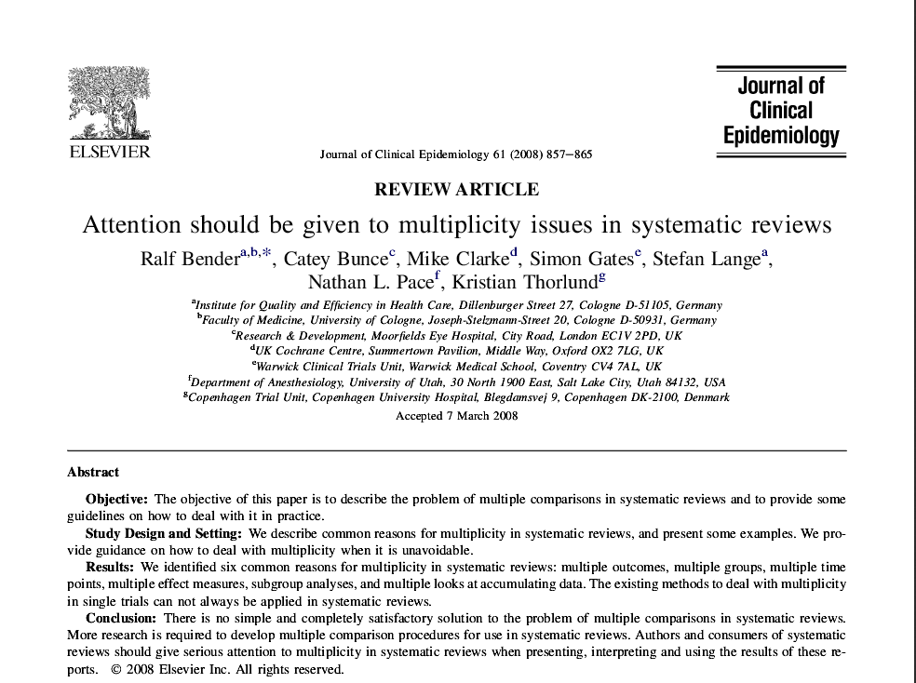
Bender R, Bunce C, Clarke M, Lange M, Pace N, and Thorlund K, Attention should be given to multiplicity issues in systematic reviews. Journal of clinical Epidemiology, 2008. 857-865

Slide 6
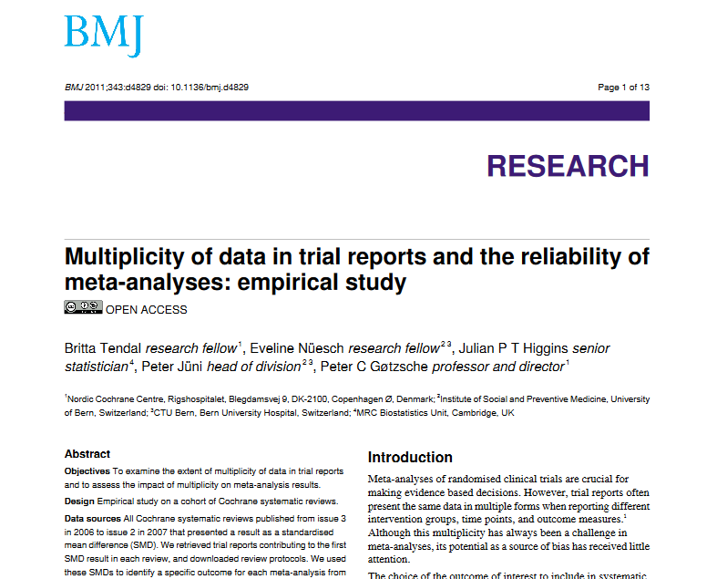
Tendal B, Nuesch E, Higgins J, Juni P and Gotzsche P. Multiplicity in trial reports and reliability of meta-analyses: empirical study. BMJ, 2011.

Slide 7
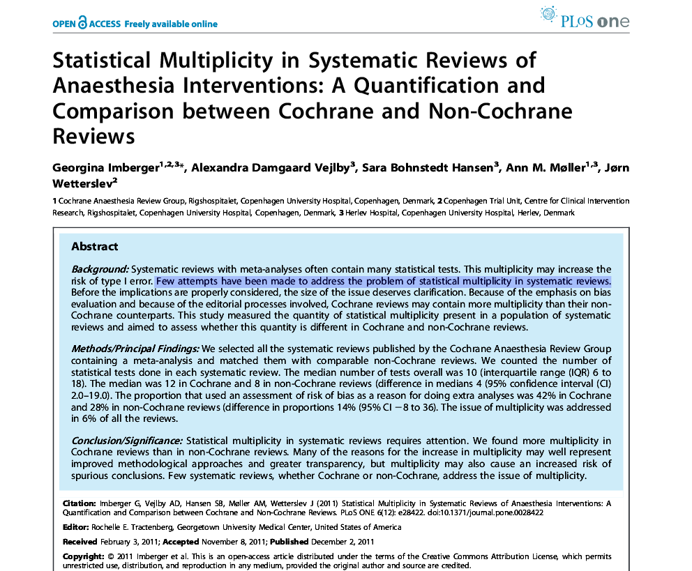
Imberger G, Veljlby A, Hansen S, Meller A, and Wetterslev J. Statistical Multiplity in systematic reviewer of anaesthesia interventions:A quantification and comparison between Cochrane and Non-Cochrane Reviews. PLoS One, 2011.

Slide 8
Imberger G, Veljlby A, Hansen S, Meller A, and Wetterslev J. Statistical Multiplity in systematic reviewer of anaesthesia interventions:A quantification and comparison between Cochrane and Non-Cochrane Reviews. PLoS One, 2011.

Slide 9
“Few attempts have been made to address the problem of statistical multiplicity in systematic reviews”
“The median was 12 in Cochrane and 8 in non-Cochrane reviews”
“Statistical multiplicity in systematic reviews requires attention”
Imberger G, Veljlby A, Hansen S, Meller A, and Wetterslev J. Statistical Multiplity in systematic reviewer of anaesthesia interventions:A quantification and comparison between Cochrane and Non-Cochrane Reviews. PLoS One, 2011.

Slide 10
Causes of multiplicity in SR
Multiple outcomes
Multiple groups (eg 3 arm trial)
Multiple time-points
Multiple effect measures
Subgroup analyses
Accumulating data

Slide 11
How common are these problems in CSG reviews
I reviewed eight CSG reviews from 2016 (where I was not an author).
The number of hypothesis tests were: 3, 3+, 4, 5, 6, 7, 12, 24. The median number of outcomes analysed was 5.5 (3-24)
Compared to the last 8 from the Cochrane library, the median was 4.5 (2-12)

Slide 12
An example of a CSG review

Slide 13

How many primary hypothesis tests ?

Slide 14

The Results Section

Slide 15
3 outcomes measured 6 ways, at two time-points
= 12 hypothesis tests

Slide 16
Guidance for dealing with multiplicity in SR
General issues
Interpret A priori outcomes in an inferential manner, and downgrade any additional outcomes when they were not explicitly stated at the protocol stage
Associate one p-value with one outcome
Reviewer teams need to raise the issue of multiple testing as a weakness
Cochrane Handbook for interventions.
16.7.2 Multiplicity in systematic reviews

Slide 17
In Summary
Define the primary outcomes clearly, state how they are measured, and state the timing of follow up

Slide 18
Heterogeneity
“Any kind of variability among studies in a systematic review may be termed heterogeneity.”
Clinical diversity (heterogeneity) – patients, drugs, settings
Methodological diversity (heterogeneity) – study design, risk of bias
Cochrane handbook: Higgins JPT, Green S (editors). Available from www.Cochrane-handbook.org.
Notes:
So I’m going to talk about heterogeneity in meta-analysis So what is heterogeneity. Well statistical heterogeneity is any kind of variability among studies in a systemaric review. It can arise from clinical heterogeneity (e.g. different drug doses, different populations), or methodological heterogeneity (e.g. different study designs, risk of bias)

Slide 19

West SL, Gartlehner G, Mansfield AJ, et al. Comparative Effectiveness Review Methods: Clinical Heterogeneity [Internet]. Rockville (MD): Agency for Healthcare Research and Quality (US); 2010 Sep. 3, Results. Available from: https://www.ncbi.nlm.nih.gov/books/NBK53317/

Slide 20
Heterogeneity
Which model should I be using? Random- or fixed-effects?
How do I identify statistical heterogeneity?
What do I do if I find statistical heterogeneity?
Notes:
So I’m going to talk about these three questions – which model should you be using for your meta-analysis, how do you identifiy statistical heterogeneitiy, and what do you do if you find it?

Slide 21
Which model?
If I² is <50% we will use “fixed-effects model”, if I² ≥50% we will use “random-effects model” (csg review, 2016).
HANDBOOK QUOTE: “The choice between a fixed-effect and a random-effects meta-analysis should never be made on the basis of a statistical test for heterogeneity.”
Notes:
So which model – random or fixed. I commonly see this section in some skin review – if I2 is <50% we will use fixed, if its >50% we will use random. In the handbook it actually says the choice between models should never be made on the basis of a statistical test for heterogeneity. Therefore, what should you be basing it on?

Slide 22
Fixed-effects estimate=‘what is the best estimate of the intervention effect?’
Random-effects estimate=‘what is the average intervention effect?’
Fixed-effects model – all studies estimating the same effect, same population, no clinical or methodological heterogeneity between studies
Random-effects model: takes into account the statistical heterogeneity (tau², between study variance) – wider CIs, higher p value
Notes:
Well firstly I’ll talk about the differences between the two models. So fixed estimate is assuming there is no clinical or methodological heterogeneity between studies – hence, populations, study designs, settings etc are very similar. It therefore asks the question – what is the best estimate of intervention effect” and assumes a common distrubition of studies. Random effects takes into the account the heterogeneity through a statistic called Tau-squared, which therefore results in wider confidence intervals but asks the question –what is the average intervention effect?

Slide 23
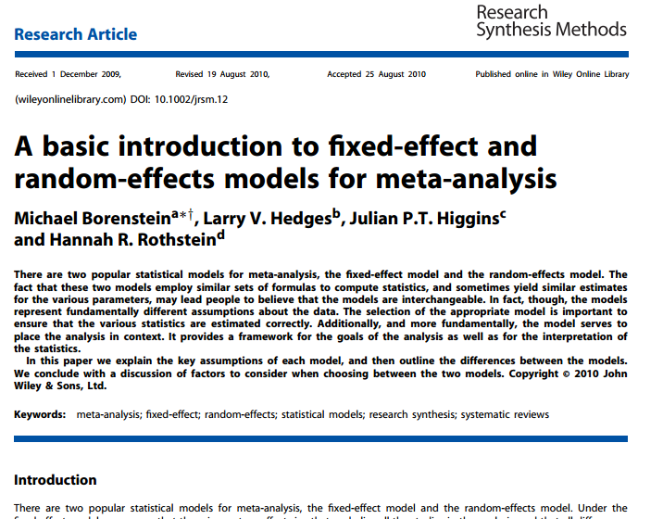
Borenstein, M., Hedges, L.V., Higgins, J. and Rothstein, H.R., 2010. A basic introduction to fixed‐effect and random‐effects models for meta‐analysis. Research Synthesis Methods, 1(2), pp.97-111

Slide 24
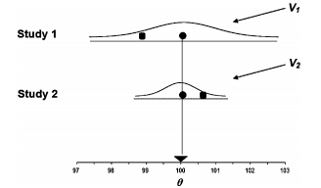
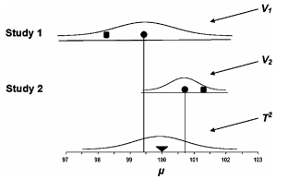
Black square=observed mean
Black circle=true mean
Fixed-effects model
Random-effects model

Slide 25
At protocol stage:
Think about you studies you expect to identify
Are the populations, setting, study design etc. similar?
In most cases I would say NO
It is very likely there will be some clinical and/or methodological heterogeneity between studies
Hence, I would recommend choosing a random-effects model
Notes:
So you should be making the decision about the model you plan to use at protocol stage. You need to think abour your studies you expect to identify. Since you are doing a Cochrane review you should know your area pretty well and should know what kind of studies you will identify. Are the populations the same? Settings etc. In most cases I would say NO. If studies are carried out by different teams there is likely to be some heterogeneity, clinically or methodologically. Therefore, I would also recommend using random-effects model.

Slide 26
How I do identify heterogeneity?
Statistical heterogeneity arises from clinical and methodological heterogeneity
Three common methods of identification:
Forest plot inspection
I²
Tau²
Notes:
So you have performed a meta-analysis using a random-effects model, and you want to look for statistical heterogeneity. There are three ways to do this:

Slide 27
1) LOOK AT YOUR FOREST PLOTS
Are the effects sizes of each study similar?
Do confidence intervals overlap?
Do studies differ in direction of effect?
Think about your studies – are they different?
Obvious differences are in study designs, patient characteristics (e.g. age, sex), setting, drug type, drug dose, comparators
How clinically important is it to pool these studies together?
Notes:
The easier thing to do is to look at your forest plots. Are the effects sizes similar? Do the confidence intervals overalap? Is your direction of effect the same? Think about your studies – are there obvious differences in study designs, patient characteristics, drug types/doses, and also comparators. Think about how clinically important it is to pool these studies.

Slide 28
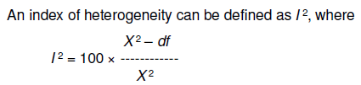

2) I²
Chi-squared (χ²): are observed differences in results compatible with chance alone
I² is the percentage of the chi-squared (χ²) statistic which is not explained by the variation within the studies.
*depends on magnitude and direction of effects and strength of evidence for heterogeneity (e.g. P value from the chi-squared test, or a confidence interval for I²).
Notes:
You can also look at I2 – this is a statistical calculated from a chi-squared test which looks at the observed differences in results compared to chance alone. I2 is the percentage not explained by chance. These are the thresholds recommend in the handbook – however, these do depend on p value from your chi-squared test and also the confidence intervals for i2.

Slide 29
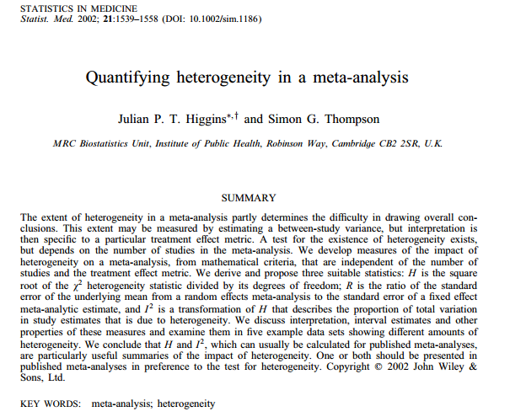
Higgins, J. and Thompson, S.G., 2002. Quantifying heterogeneity in a meta‐analysis. Statistics in medicine, 21(11), pp.1539-1558

Slide 30
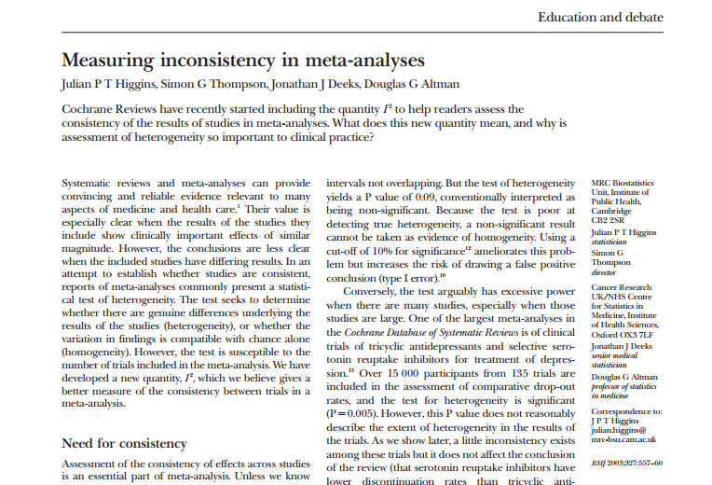
Higgins, J.P., Thompson, S.G., Deeks, J.J. and Altman, D.G., 2003. Measuring inconsistency in meta-analyses. Bmj, 327(7414), pp.557-560.

Slide 31
Flaws of I²
“represents the approximate proportion of total variability in point estimates that can be attributed to heterogeneity”
“does not estimate a meaningful parameter, so should be regarded as a descriptive statistic rather than a point estimate.”
“A more appropriate descriptor for I² would be a measure of inconsistency, since it depends on the extent of overlap in confidence intervals across studies”
”
Higgins, J.P., 2008. Commentary: Heterogeneity in meta-analysis should be expected and appropriately quantified. International journal of epidemiology, 37(5), pp.1158-1160.
Notes:
There are flaws with I2 – it is an estimate of variability that can be attributed to heterogeneity. It is a useful statistic to consider however it is a descriptive statistic and should be interpreted with caution. It may be better at describing inconsistency in your grade assessment

Slide 32
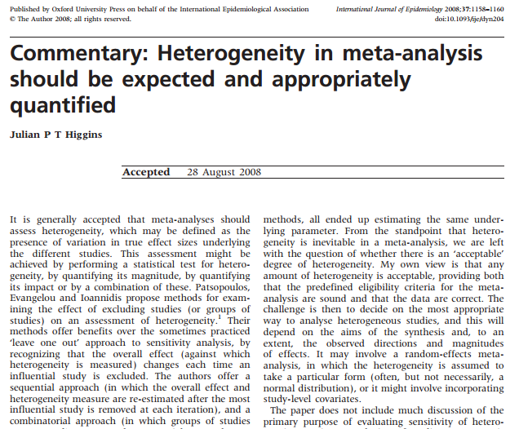
Higgins, J.P., 2008. Commentary: Heterogeneity in meta-analysis should be expected and appropriately quantified. International journal of epidemiology, 37(5), pp.1158-1160

Slide 33
3) Tau²
“The difference between these two values will give us the variance between-studies, which is called tau-squared (τ²).”
Used in the random-effects model
Is more difficult to interpret
If >1, substantial statistical heterogeneity
Notes:
Tau2 is another statistics – this shows the variance between the studies and is used in the random-effects model to calculate the weights. It is more difficult to intreprate than I2 as there are any thresholds, however, generally if it’s greater than 1 then it may suggest substantial statistical heterogeneity.

Slide 34
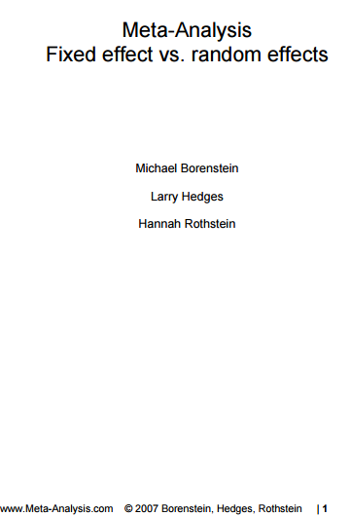
Available at: https://www.meta-analysis.com/downloads/Meta-analysis%20fixed%20effect%20vs%20random%20effects.pdf

Slide 35
How to deal with statistical heterogeneity?
If identified through forest plot inspection and I² or Tau²:
  Think about your studies!! Are they are obvious differences?
  Subgrouping and sensitivity analyses
    Do you pre-planned analysis, and any others
  Downgrade for inconsistency in your GRADE assessments
  Does the heterogeneity matter? Do it change the direction and magnitude of the effect size?
  Do not pool – but you must always explain why and be upfront about any subgroup/sensitivity analyses you did to try and explore heterogeneity
Notes:
So if do suspect there is statistical heterogeneity from forest plot inspection and statistical tests, you should think about your studies. Consider doing subgroup or sensitivity analyses to explore heterogeneity. You should have planned some subgroup analyses in your protocol, therefore undertake these. But also explore other factors which you may not have though about at protocol stage. Sometime you are limited by the number of studies in your meta-analysis, so subgroup isn’t always possible. But you should always narratively discuss potential reasons for heterogeneity in your review. If subgrouping does not explain why there is statistical heterogeneity, then you can always downgrade your effect size for inconsistency. Furthermore, you may decide

Slide 36
To summarise:
It is very likely there will be between study heterogeneity
Use random-effects model
Identify statistical heterogeneity through forest plot inspection, I² and Tau² values
Think about your studies, and perform subgroup/sensitivity analyses (if enough studies)
Use GRADE
Consider if pooling is appropriate
Don’t rely all of your decisions on I² – it is an estimate and should only be used as a guide

Slide 37
Any Questions
Emma.Mead@nottingham.ac.uk
ben.carter@kcl.ac.uk

