Slide 1
MECIR: the bits that reviewers keep getting wrong!
Cochrane Skin Editorial Base

Slide 2

Who knows what MECIR is?

Slide 3

MECIR = a list of methodological expectations that all Cochrane Reviews and Protocols need to meet to allow for publication.
These are referred to as the MECIR standards:
Methodological
Expectations of
Cochrane
Intervention
Reviews

Slide 4


Why is MECIR important?
Quality: improves and maintains the quality of Cochrane Reviews.
Standards: helps authors adhere to standard methodological practices (e.g. the inclusion of GRADE).
Expectations: clear and transparent expectations of review conduct and reporting.

Slide 5
Where to start
The MECIR standards are presented in one document.
Different sections – for each stage:
Protocol
Review
Update

Slide 6
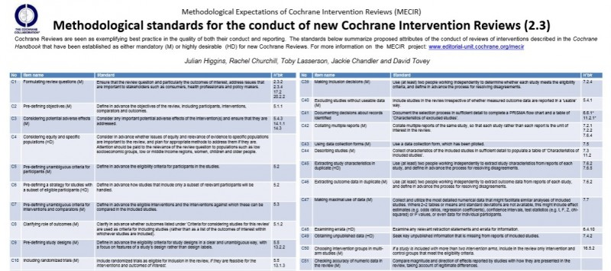
Originally... 2 sections:
Conduct of new reviews
Reporting of new reviews

Slide 7
Now... 4 sections:
Conduct of new reviews
Reporting of new reviews
AND
Reporting of protocols for new reviews
Planning, conduct, and reporting of updates
Each standard pre-fixed with ‘C’: C1, C2, C3, etc.
Each standard pre-fixed with ‘R’: R1, R2, R3, etc.
Each standard pre-fixed by ‘PR’: PR1, PR2, etc.
Each standard pre-fixed by ‘UR’: UR1, UR2, etc.

Slide 8

Do I have to implement all of the standards?

Slide 9
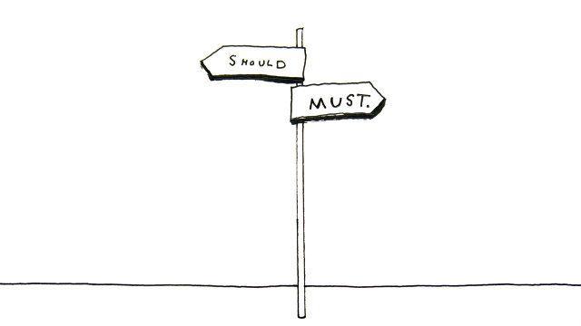
No!
The standards are labelled either Mandatory or Highly Desirable.
You have to implement the mandatory standards.

Slide 10
We will not accept a submission for peer review unless it meets the mandatory MECIR standards.
If you take one thing away from this presentation...

Slide 11
Even if you started your review before MECIR was released, you need to meet the mandatory standards.
The mandatory standards are the criteria that the editorial base check submissions against.

Slide 12
The bits reviewers keep getting wrong

Slide 13

1. Search date must be less than one year old at publication

Slide 14
Search date must be less than one year old at publication
What is mandatory:
C37 Rerun or update searches for all relevant databases within 12 months before publication of the review or review update, and screen the results for potentially eligible studies.
What is highly desirable (and our preference):
C38 Fully incorporate any studies identified in the rerun or update of the search within 12 months before publication of the review or review update.
Why?
The incorporated search date is the date to which the conclusions of the review are valid.

Slide 15

2. Summary of findings (SOF) tables
Choose one main comparison from the review for the main SoF (you can also have additional SoFs)
Choose up to 7 outcomes to include in the SoF (avoid multiple time-points)
Assess the quality of evidence for each outcome (GRADE): risk of bias, imprecision, inconsistency, indirectness and publication bias
Present the effects or impact of the intervention (relative and absolute) – for dichotomous and continuous outcomes
MECIR standards: C23, C74, C75, PR39, PR40, R97, R98, U11, UR5.
SOF: Ryan R, Santesso N, Hill S (2016) Preparing Summary of Findings (SoF) tables. Cochrane Consumers and Communication Group, available at http://cccrg.cochrane.org/author-resources. Version 1.0 June 2016.
GRADE: http://training.cochrane.org/path/grade-approach-evaluating-quality-evidence-pathway

Slide 16
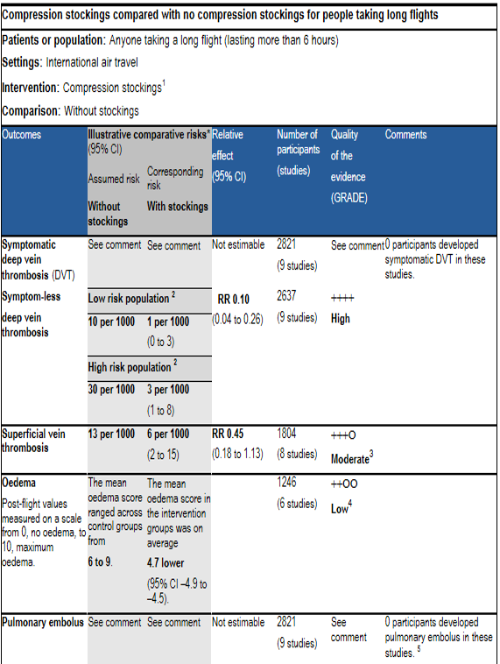
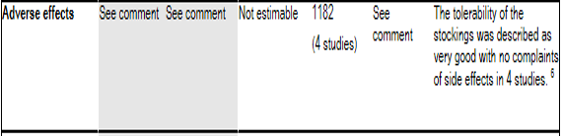
Outcome – name, length of follow up, scale
Provide setting of intervention
Footnotes to justify downgrading
Risk and relative effect for dichotomous outcomes
Include even if no or limited data – use comment box or footnotes
Use risk boxes for continuous outcomes (not relative effect)
Include adverse events
Higgins JPT, Green S (editors). Cochrane Handbook for Systematic Reviews of Interventions Version 5.1.0 (updated March 2011). The Cochrane Collaboration, 2011. Available from www.Cochrane-handbook.org.

Slide 17
3. Reporting on all key outcomes (all primary outcomes and key secondary outcomes)

Slide 18
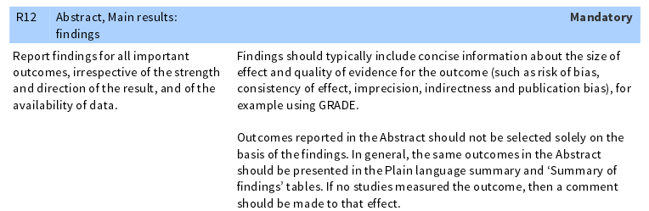
R12 ‘Report findings for all important outcomes’

Slide 19
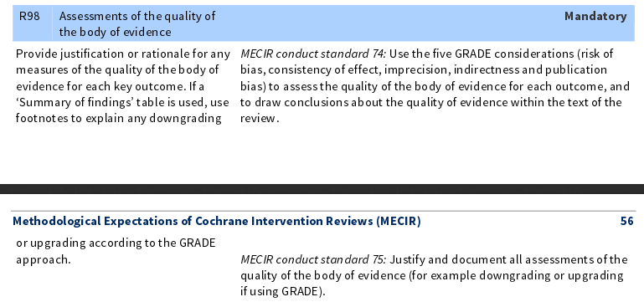
R98 ‘Assessments of the quality of the body of evidence...for each key outcome’

Slide 20
Anchor results to your important outcomes.
Make it clear that you have reported on your key outcomes.

Slide 21
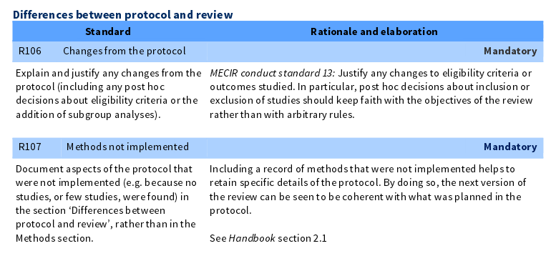
4: Differences between protocol and review

Slide 22

Document aspects of the protocol that were not implemented (e.g. because no studies, or few studies, were found) in the section Differences between protocol and review rather than in the Methods section.
Choose the appropriate section!

Slide 23
What to include
New methods used
Non-implemented methods
Explain changes in methods: where and why
Remember! Whether an update or review, you are always looking for differences from the protocol.

Slide 24
So if you want your review accepted…
You must implement the mandatory MECIR standards
Your search date must be less than one year old at publication
At least one summary of findings table is highly desirable, and GRADE assessment is mandatory
Report on all key outcomes
Report on changes to what you planned

Slide 25

Where to find MECIR
http://methods.cochrane.org/mecir

Slide 26
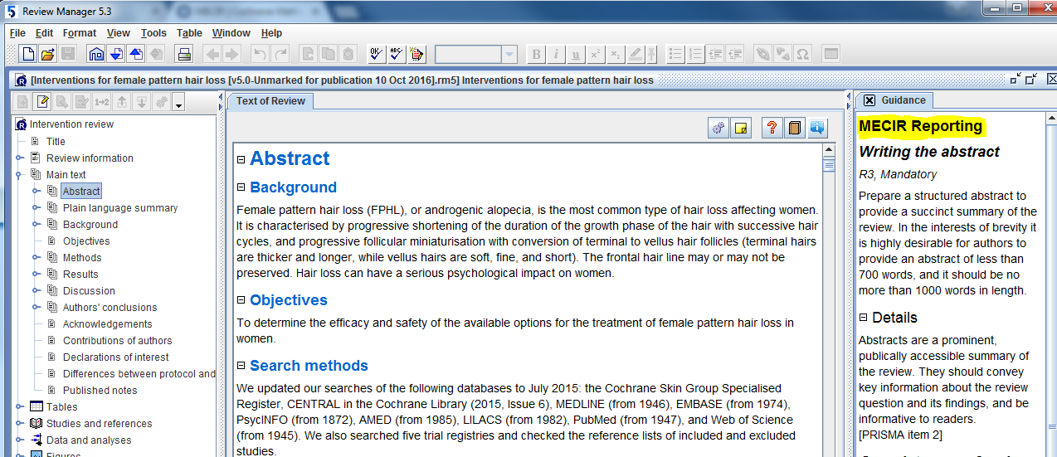
Where to find MECIR
On the right hand side in RevMan (though this might not yet be up-to-date with the new standards)

