Slide 1
Cochrane Skin Prioritisation Project
Bob Boyle,
Incoming Joint Co-ordinating Editor of Cochrane Skin
Amsterdam, January 16th 2018

Slide 2
Title Prioritisation Project
Why do we need to prioritise Cochrane systematic review titles?
Cochrane Skin prioritisation process 2017
Outcomes of the 2017 prioritisation project
Future plans…

Slide 3
Title Prioritisation Project
Why do we need to prioritise Cochrane systematic review titles?
Cochrane Skin prioritisation process 2017
Outcomes of the 2017 prioritisation project
Future plans…

Slide 4
Systematic Review Landscape
22 SRs are published each day, >8000 per year
3-fold increase between 2004 and 2014
15% are Cochrane reviews (20% in 2004)
55% are therapeutic – 25% epidemiology ↑ – 11% diagnosis/prognosis
52% from China ↑, UK or USA
PLOS Medicine 2016;13(5):e1002028

Slide 5
Cochrane Skin Reviews as a % of all Dermatology Systematic Reviews

Slide 6
Quality of Systematic Reviews
38% published in good journals (IF≥5) i.e. 27% of non-Cochrane reviews
2% published in a leading journal (IF>15)
General increase in quality e.g. specified primary outcome (37% in 2004, 48% in 2014 for non-Cochrane reviews)
PLOS Medicine 2016;13(5):e1002028

Slide 7
Systematic Review Threats
40% have potentially misleading conclusions, due to not taking into considerations the limitations of the studies included in the review
Estimated 67% of SRs have at least one overlapping review published within 3 years
BMJ. 2013;347:f4501. pmid:23873947
PLOS Medicine 2016;13(5):e1002028

Slide 8
Cochrane vs Non-Cochrane Reviews
Methodological quality of Cochrane vs Non-Cochrane Reviews of Therapeutic Interventions
PLOS Medicine 2016;13(5):e1002028

Slide 9
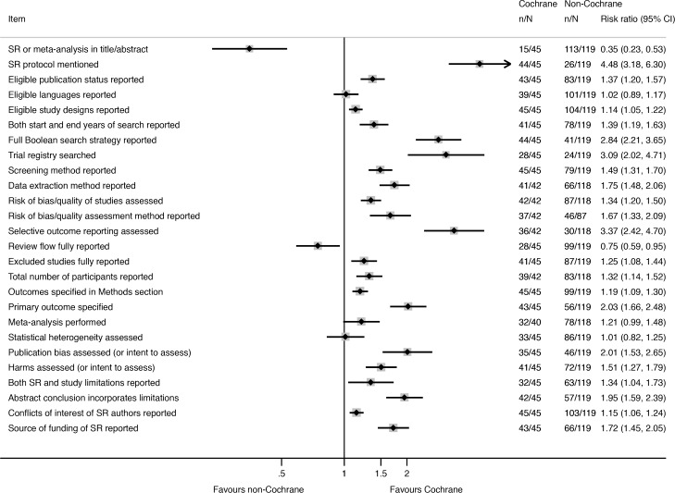
Cochrane vs Non-Cochrane Reviews
Methodological quality of Cochrane vs Non-Cochrane Reviews of Therapeutic Interventions
PLOS Medicine 2016;13(5):e1002028

Slide 10
Cochrane 2020
‘Our vision is to refine our review production systems so that they are able to produce high quality, relevant reviews more rapidly and efficiently; and to create an environment and a more integrated, flexible organizational structure that provides maximum support and opportunities for our most precious resource – our contributors.’

Slide 11
Title Prioritisation Project
Why do we need to prioritise Cochrane systematic review titles?
Cochrane Skin prioritisation process 2017
Outcomes of the 2017 prioritisation project
Future plans…

Slide 12
CSG Prioritisation Process 2017
Title suggestions
Summarise results
Top 10 ranking by Editors

Slide 13
Priority Title Suggestions
Professional societies
Guideline development groups
Healthcare commissioners
CSG membership
Consumers and consumer organisations
Disease-specific priority setting exercises e.g. JLA partnerships, guideline recommendations for future research

Slide 14
Summarising Title Suggestions – GBD ‘top 15’ conditions

Slide 15
Top 10 Ranking by Editors
Diseases ranked highest if on GBD ‘top 15’ conditions, and not well represented in CSG reviews (Dellavalle 2014 review)
Scored 10 for top ranked, 1 for lowest ranked, and summed scores
Final list reviewed by editorial base, with respect to ongoing titles and number of reviews that could be supported

Slide 16
Title Prioritisation Project
Why do we need to prioritise Cochrane systematic review titles?
Cochrane Skin prioritisation process 2017
Outcomes of the 2017 prioritisation project
Future plans…

Slide 17
Final Priority Title List
7 priority titles :
1. Treatments for severe drug reactions (protocol)
2. Interventions for alopecia areata (update)
3. Educational programmes for the primary
prevention of skin cancer (review)
All ‘ongoing’ and will be supported as priority reviews

Slide 18
New Priority Titles
1. Interventions for pruritus of unknown cause
Ibero-American Cochrane Centre
2. Network meta-analysis of topical eczema
treatments
Singapore Cochrane Centre
3. Network meta-analysis of systemic eczema
treatments
Malaysian Cochrane Centre
4. Interventions for folliculitis and boils.
Taiwan Cochrane Centre

Slide 19
Timeline for priority titles
November 2018 – winning teams announced
…Deadline for protocol acceptance for peer review:
16th March 2018
…Protocol peer review and publication:
18th May 2018
…Deadline for SR acceptance for peer review:
17th May 2019
Total review production time: just over 18 months

Slide 20
Title Prioritisation Project
Why do we need to prioritise Cochrane systematic review titles?
Cochrane Skin prioritisation process 2017
Outcomes of the 2017 prioritisation project
Future plans…

Slide 21
Cochrane 2020
‘Our vision is to refine our review production systems so that they are able to produce high quality, relevant reviews more rapidly and efficiently; and to create an environment and a more integrated, flexible organizational structure that provides maximum support and opportunities for our most precious resource – our contributors.’

Slide 22
Cochrane Structure & Function Review
CSG will become one of 8 review groups in the
‘Long-term conditions and ageing network’
Back and neck
ENT
Eyes and Vision
Musculoskeletal
Oral Health
Pain, Palliative and Supportive Care
Skin
Wounds
Notes:
We are writing to you as one of Cochrane Skin’s key stakeholders. We would like to ask you if you would think about what reviews or updates you would like us to prioritise over the next three years. We are writing to a wide range of stakeholders, and we will gather your views together and then make a final shortlist with our international editors and feedback to you at that stage. We are open to suggestions of new review questions that are not already on our existing list of reviews and protocols (click on 'Full list'). New reviews should be concerned with healthcare interventions. Now that we have good methodologists in our team, we are also interested in doing more methodologically challenging systematic reviews that involve techniques such as network meta-analysis, individual patient meta-analysis and diagnostic test accuracy reviews.
The Cochrane Skin Group has now been running for 20 years, and we are proud of the 100+ high quality systematic reviews that have been produced over that period. It is difficult to keep expanding on new and updated reviews year on year, as we only have so much capacity at the editorial base to manage the review process and ensure quality and relevance to a wide range of stakeholders. That means we will have to prioritise reviews much more in the future. Perhaps that will mean ending up doing less reviews, so we want to ensure that they are the reviews most needed by our stakeholders. We are particularly interested in reviews that are key to informing guidelines or policy, or that are funded by our stakeholders. We are also open to reviews that deal with the big problems in low to middle income countries, if we have not covered them already.
So for now, please let us know what you regard as the most important topics for us to prioritise as Cochrane Skin reviews in the next three years, listing a maximum of 5 specific questions listed in rank order (with 1 being most important and 5 being least important to you). Just send us back your suggestions via email and we will take it from there. Please respond by Tuesday 18th April 2017.
Many thanks and best wishes,
Bob Bob Boyle, Deputy Co-ordinating Editor Cochrane Skin Group

Slide 23
Less reviews, higher priority
No ‘routine’ updates of existing reviews
Updates more targeted
Reviews and protocols submitted to CSG which are not ready to go out for peer review are given one opportunity to revise
More complex methods support from Cochrane
Faster editorial turnaround and publication times
Notes:
We are writing to you as one of Cochrane Skin’s key stakeholders. We would like to ask you if you would think about what reviews or updates you would like us to prioritise over the next three years. We are writing to a wide range of stakeholders, and we will gather your views together and then make a final shortlist with our international editors and feedback to you at that stage. We are open to suggestions of new review questions that are not already on our existing list of reviews and protocols (click on 'Full list'). New reviews should be concerned with healthcare interventions. Now that we have good methodologists in our team, we are also interested in doing more methodologically challenging systematic reviews that involve techniques such as network meta-analysis, individual patient meta-analysis and diagnostic test accuracy reviews.
The Cochrane Skin Group has now been running for 20 years, and we are proud of the 100+ high quality systematic reviews that have been produced over that period. It is difficult to keep expanding on new and updated reviews year on year, as we only have so much capacity at the editorial base to manage the review process and ensure quality and relevance to a wide range of stakeholders. That means we will have to prioritise reviews much more in the future. Perhaps that will mean ending up doing less reviews, so we want to ensure that they are the reviews most needed by our stakeholders. We are particularly interested in reviews that are key to informing guidelines or policy, or that are funded by our stakeholders. We are also open to reviews that deal with the big problems in low to middle income countries, if we have not covered them already.
So for now, please let us know what you regard as the most important topics for us to prioritise as Cochrane Skin reviews in the next three years, listing a maximum of 5 specific questions listed in rank order (with 1 being most important and 5 being least important to you). Just send us back your suggestions via email and we will take it from there. Please respond by Tuesday 18th April 2017.
Many thanks and best wishes,
Bob Bob Boyle, Deputy Co-ordinating Editor Cochrane Skin Group

Slide 24
Prioritisation updates
New review titles/suggestions always welcome
Urgent priority reviews will be assessed by the editorial team at their weekly meeting
Other suggestions will be reviewed annually
Formal prioritisation process will be repeated every 2-3 years – likely late 2019
Notes:
We are writing to you as one of Cochrane Skin’s key stakeholders. We would like to ask you if you would think about what reviews or updates you would like us to prioritise over the next three years. We are writing to a wide range of stakeholders, and we will gather your views together and then make a final shortlist with our international editors and feedback to you at that stage. We are open to suggestions of new review questions that are not already on our existing list of reviews and protocols (click on 'Full list'). New reviews should be concerned with healthcare interventions. Now that we have good methodologists in our team, we are also interested in doing more methodologically challenging systematic reviews that involve techniques such as network meta-analysis, individual patient meta-analysis and diagnostic test accuracy reviews.
The Cochrane Skin Group has now been running for 20 years, and we are proud of the 100+ high quality systematic reviews that have been produced over that period. It is difficult to keep expanding on new and updated reviews year on year, as we only have so much capacity at the editorial base to manage the review process and ensure quality and relevance to a wide range of stakeholders. That means we will have to prioritise reviews much more in the future. Perhaps that will mean ending up doing less reviews, so we want to ensure that they are the reviews most needed by our stakeholders. We are particularly interested in reviews that are key to informing guidelines or policy, or that are funded by our stakeholders. We are also open to reviews that deal with the big problems in low to middle income countries, if we have not covered them already.
So for now, please let us know what you regard as the most important topics for us to prioritise as Cochrane Skin reviews in the next three years, listing a maximum of 5 specific questions listed in rank order (with 1 being most important and 5 being least important to you). Just send us back your suggestions via email and we will take it from there. Please respond by Tuesday 18th April 2017.
Many thanks and best wishes,
Bob Bob Boyle, Deputy Co-ordinating Editor Cochrane Skin Group

Slide 25
Cochrane 2020
Cochrane cannot afford to commit resources to reviews which are low-impact or extensively delayed
Focussed on supporting rapid delivery of a smaller number of high priority reviews
New methodologies – DTA, IPD, NMA etc
Cochrane Skin is now part of a network of 8 Cochrane groups – ‘long term conditions and ageing’

