Slide 1

Targeted update in Infantile haemangiomas
(Strawberry birthmarks)
Dr. Mónica Novoa
Pediatric Dermatologist
Hospital de la Santa Creu i Sant Pau
Barcelona, Spain
San José Hospital -F.U.C.S
Bogotá, Colombia, South America
Notes:
Good afternoon Ladies and Gentlemen, I’m Monica Novoa, I’m a Pediatric Dermatologist, from Bogota, Colombia.
Thank you for inviting me here today, I want to take the time, to talk to you about the two target updates of interventions for infantile haemangiomas, and how we all work together as part of a team.

Slide 2
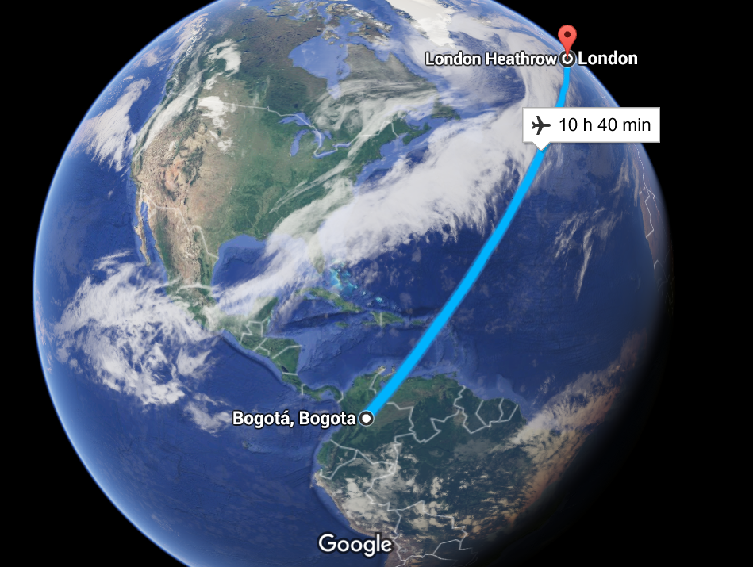
Notes:
Colombia is located here , north of South America, Bogota is here center of the country.

Slide 3
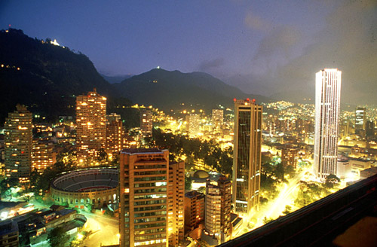
Notes:
This is Bogota, the capital of Colombia

Slide 4
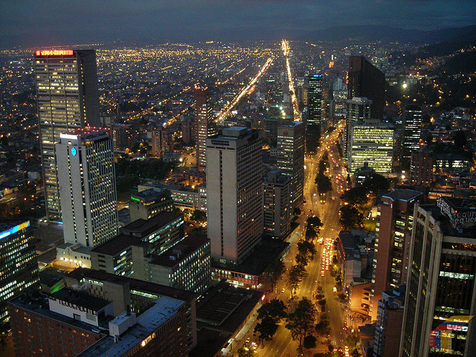
Notes:
This is the center of the city

Slide 5
CORE TEAM
Mónica Novoa¹, Eulalia Baselga², Sandra Beltran¹, Ali Shahbaz³, Lucia Giraldo¹, Ingrid Arevalo-Rodriguez⁴
¹Dermatology, San José Hospital -Fundación Universitaria de Ciencias de la Salud, Bogotá, Colombia
²Dermatology, Hospital de la Santa Creu i Sant Pau, Barcelona, Spain
³Medicine, University of Ottawa – Faculty of Medicine, Ottawa, Canada
⁴Division of Research, Fundación Universitaria de Ciencias de la Salud - San José Hospital . Bogotá D.C., Colombia
Notes:
Now, I want to introduce the core team, Dr. Ali Shahbaz, he works in faculty of medicine in Ottawa, Canada

Slide 6
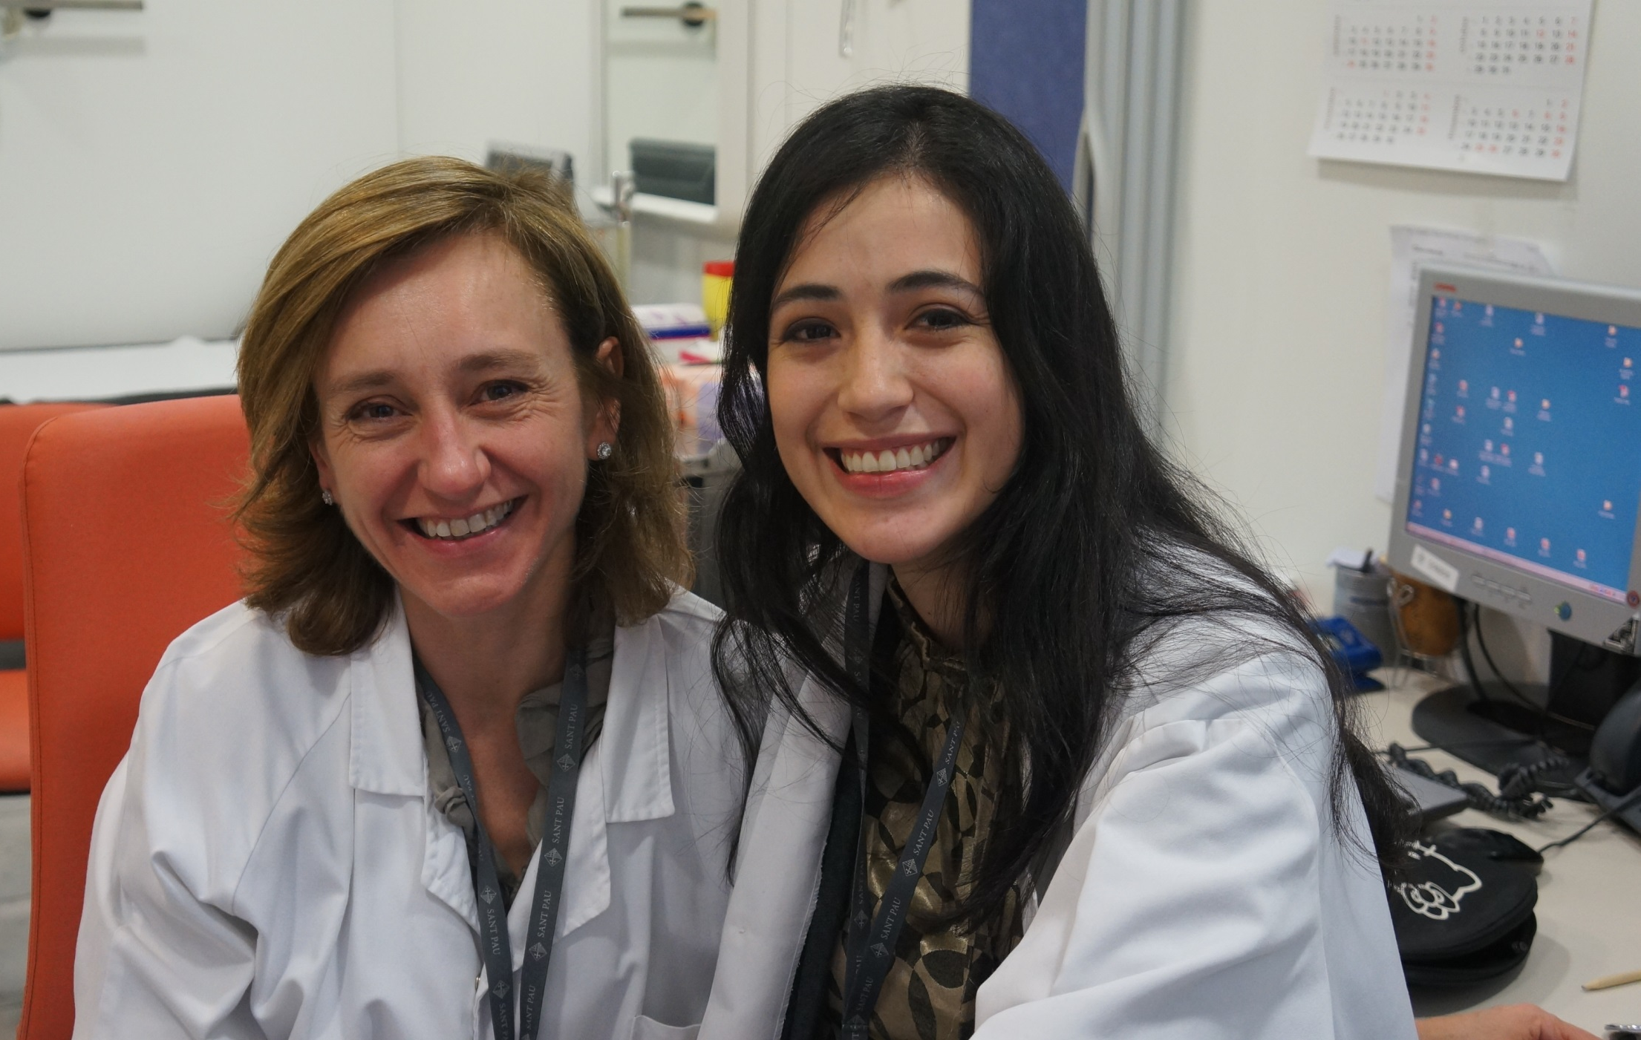
Notes:
Dr. Eulalia Baselga is a Pediatric Dermatologist too, she works in Sant Pau Hospital in Barcelona, Spain

Slide 7
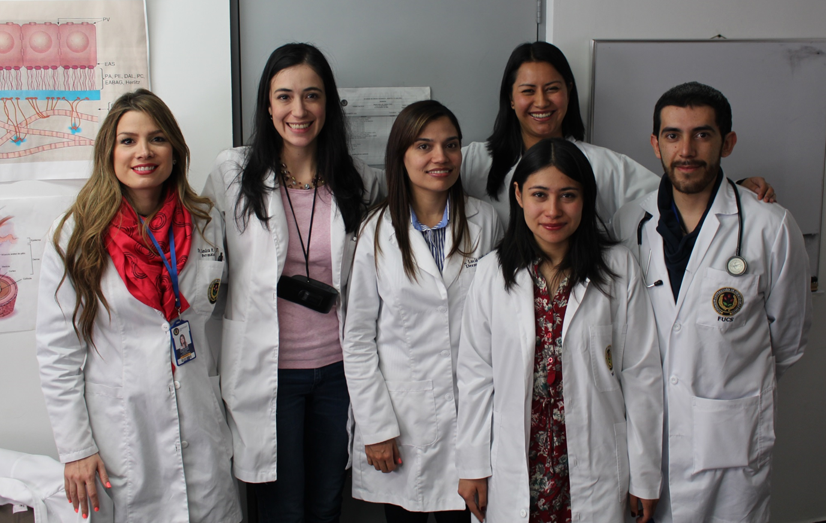
CORE TEAM
Dr. Sandra Beltran
Dr. Lucia Giraldo
Notes:
This is Drs Sandra Beltran and Lucia Giraldo who work with me, they are dermatology residents

Slide 8
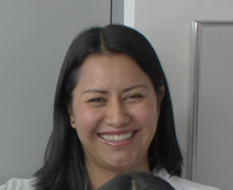
CORE TEAM
Dr. Ingrid Arevalo-Rodriguez
Notes:
and Ingrid Arevalo is our Cochrane Collaborative Unit Coordinator

Slide 9
Notes:
This is our group who work in Bogota

Slide 10

Notes:
This is San Jose Hospital where I work, this is a university hospital it was built in 1902 and was one of the first hospitals in Colombia.

Slide 11
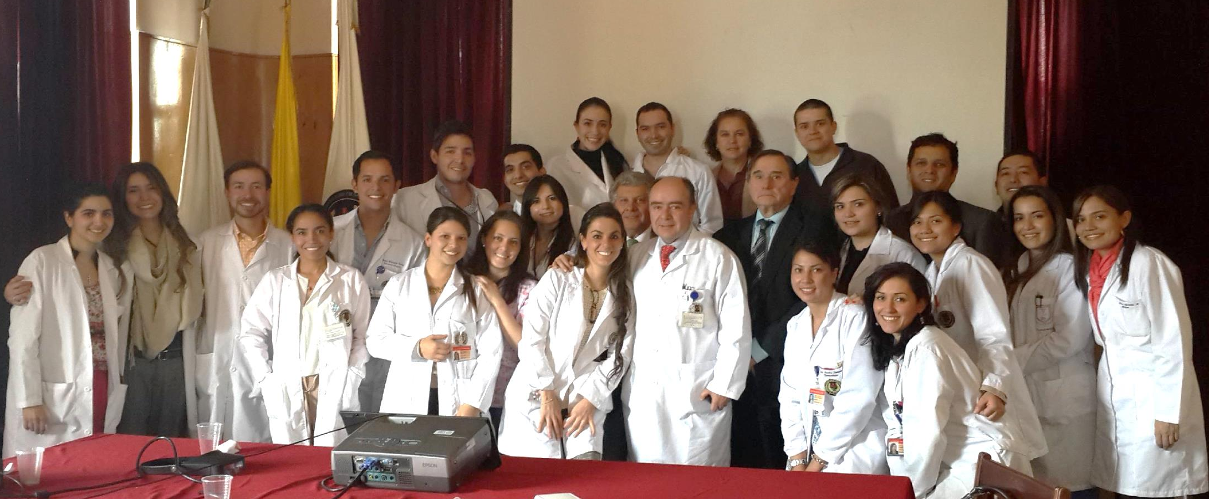
DERMATOLOGY DEPARTMENT
Notes:
This is a picture of the Dermatology Department with all teachers , residents and students

Slide 12
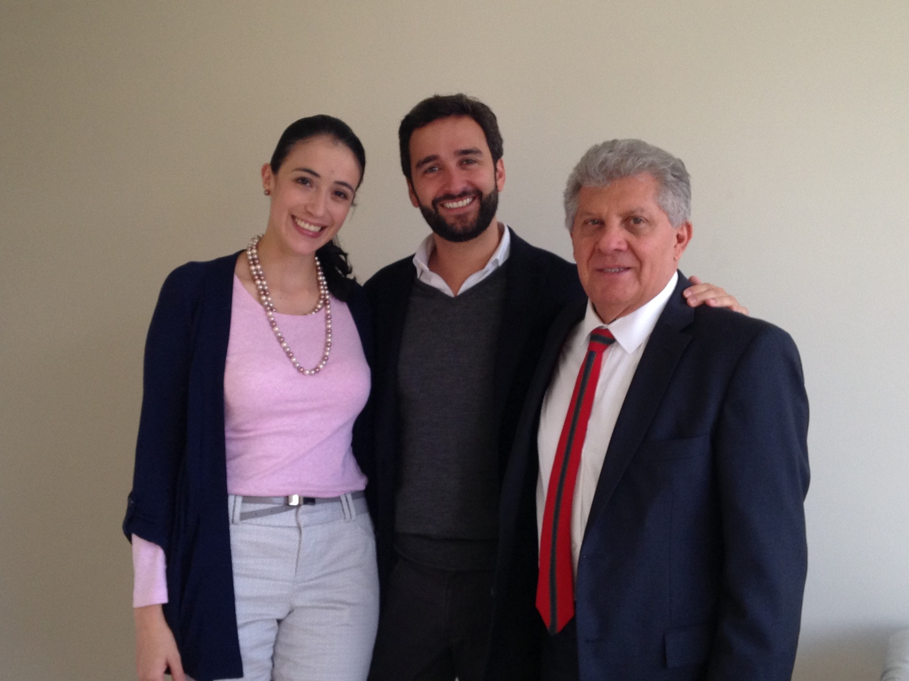
PEDIATRIC DERMATOLOGY TEAM
Notes:
And This is the pediatric dermatology team, Dr. Antonio Barrera, Dr. Mauricio Torres and myself.

Slide 13
Dermatology Department
San Jose Hospital
2300 patients seen every month
850 of them are children
35% Atopic dermatitis
25% Acne
20% Vascular lesions ( malformations and tumors)
10% Skin Infections ( warts and contagious molluscum
10% other
Notes:
On a regular month, we see 2300 patients, 850 of them are children, with
different pathologies, 20% of which are vascular lesions, so this is why we were interested to participate in the update of this cochrane systematic review

Slide 14
RESEARCH
COLCIENCIAS (Col- science) recognized the Group as D category in 2014
Research lines:
  Clinical Dermatology – Psoriasis
  Medical Education in Dermatology
Notes:
The Dermatology Department is recognized by COLCIENCIAS ( COL – SCIENCE), a Colombian government body that over see’s the research department, actually we have two dermatology fields of research

Slide 15
Cochrane Collaborator Unit
Belonging to a Research Division - Fundación Universitaria de Ciencias de la Salud (Bogotá, Colombia, South America).
Involved in several systematic review (intervention and diagnostic test accuracy).
In Dermatology field:
  Sun protection for preventing basal cell and squamous cell skin cancers (http://onlinelibrary.wiley.com/doi/10.1002/14651858.CD011161/abstract)
  Interventions for infantile haemangiomas (strawberry birthmarks) of the skin (http://onlinelibrary.wiley.com/doi/10.1002/14651858.CD006545.pub2/abstract)
Notes:
The Cochrane unit, is part of the research division within San Jose Hospital. We have 2 Dermatology fields, first is the Sun protection for preventing skin cancers and Interventions for infantile haemangiomas of the skin.
Now I will talk to you about our role, and how we have updated the treatments from the last publication 5 years ago.

Slide 16
Notes:
This is the document that was last reviewed 5 years ago, by doctors Leonardi and her team.

Slide 17
Our main objective was to update the Systematic Review published on 2011 emphasing in the adverse effects of interventions for management of infantile haemangiomas.
Notes:
Our main objective is to update the Systematic Review published in 2011 emphasing on the adverse effects of interventions for management of infantile haemangiomas, and in April last year we were invited to participate in a pilot scheme

Slide 18
Update Target Haemangiomas
Objective : To explore a novel approach to updating Cochrane Reviews to address the needs of policy-makers and other decision makers.
Founders: The Cochrane Editorial Unit, Cochrane Innovations and Enhance Reviews.
Team:
  Karla Soarez-Weiser
  Nuala Livingstone
  Rachel Churchill
  Rachel Marshall
  Giulia Boselli
  Charlotte Pestridge
Phase: Pilot
Notes:
The main objective of the pilot scheme was to explore a novel approach to updating Cochrane Reviews to address the needs of policy-makers and other decision makers.
We work with another fantastic group, located here in the UK, The team consists of Karla Soarez and her team
we are working closely together, to do a quick document that updates 2 main treatments: oral propranolol and topical timolol, with a view to becoming permenant and also useful and relevant for future Sistematic reviews.

Slide 19
Flow chart
Phase 1. Approval and first meeting
Update of systematic review was approved by CSG in March 2015.
Phase 2. Development of project
Search results provided by Elizabeth Doney in June 2015.
Phase 3. Edition of documents and peer-review process
TU documents received in November 2015.
Request regarding Target update project (Pilot) in April 2015.
Conference call: First agreements in May 2015
Screening results the last week of June.
Additional clarifications about selected references in August 2015.
Developing of documents: During this phase.
Peer-review process: From December 2015 to January 2016.
Final documents in copy-editing process: Late January 2016.
Documents published in March 2016
10 months aprox.
Notes:
This is the flow chart of the project, that we have been working on, I want to show the process of the pilot project.
In December 2014, we submitted to the skin cochrane group the documents to begin the update of the systematic reviews for management of IH, that was approved in March last year. Then in april the request regarding the TARGET UPDATE PROJECT (pilot) was accepted and we had our first conference call back in May.
During phase 2 we developed the project.
In the first days of June, the search results were provided by Elizabeth Doney, and we screened the results towards the end of June.
We did additional clarifications for the selected references in August. During this period we worked on developing the review, in terms of finding additional articles, extraction of qualitative and numerical data and estimation of bias.
In phase 3, when we received the documents back in November that Nottingham were working on, we did the review and the relevant amendments were sent back for assessment by Cochrane Skin Group peers, and now we have the final edited documents that will be published in March. Ten months later.

Slide 20
Advantages
Definition of adverse events during their activities in conjunction with both teams
The literature search was developed and the results was provided by UK team
Double check information
Notes:
The advantages working together, are to do double check information, assign tasks to each group in the literature search and definition of adverse events, also this is time sensitive, so 2 minds are better than 1

Slide 21
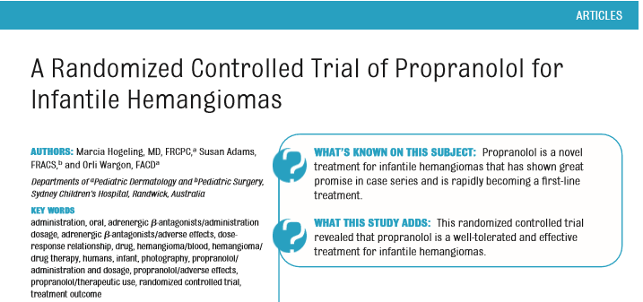
Selected Articles
Hogeling M, Adams S, Wargon O. Pediatrics 2011, 128(2): e259-66
Notes:
After performing the literature search, 3 trials of oral propranolol were selected out of the 20 we chose in the total search. There are a randomized controlled trial of propranolol for IH written by Hogeling and his team, published in Pediatrics

Slide 22
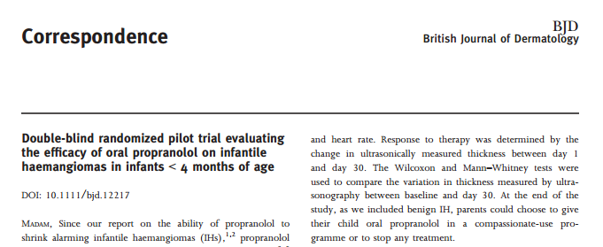
Selected Articles
2. Leaute –Labreze C, Dumas de la Roque E, Nacka F, et al. Br J Dermatology 2013, 169(1): 181-3
Notes:
The second article was double blind randomized pilot trial evaluating the efficacy of oral propranolol on IH in infants younger than 4 months. Written by Leaute-Labreze and her team that was published in Br journal of dermatology.

Slide 23
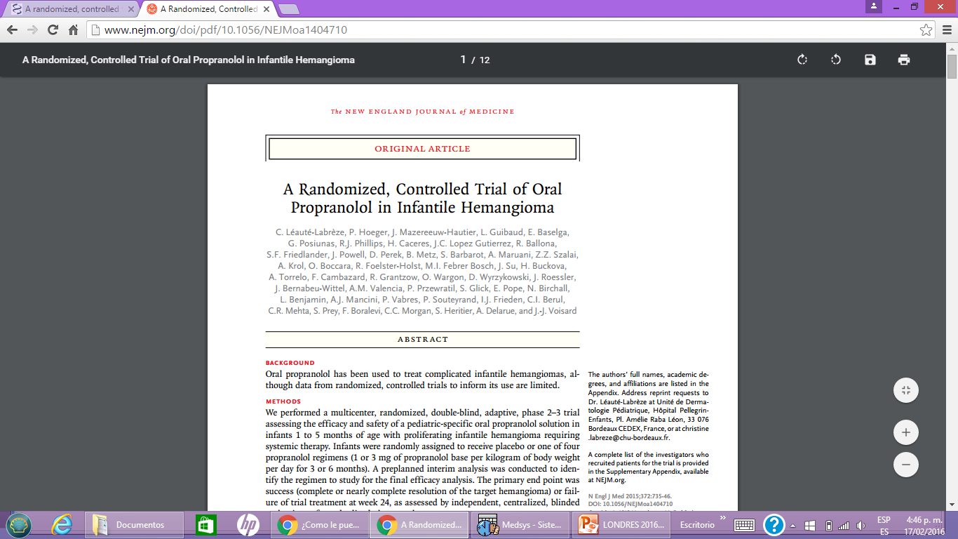
Selected Articles
Leaute –Labreze C, Hoeger P, Mazereeuw-Hautier J et al. NEJM 2015, 372(8):735-46
Notes:
And the third article was and randomized controlled trial of oral propranolol in IH, written by Leaute-Labreze and her team published in NEJM, Based on these articles, the document was written. And no ongoing studies were identified

Slide 24
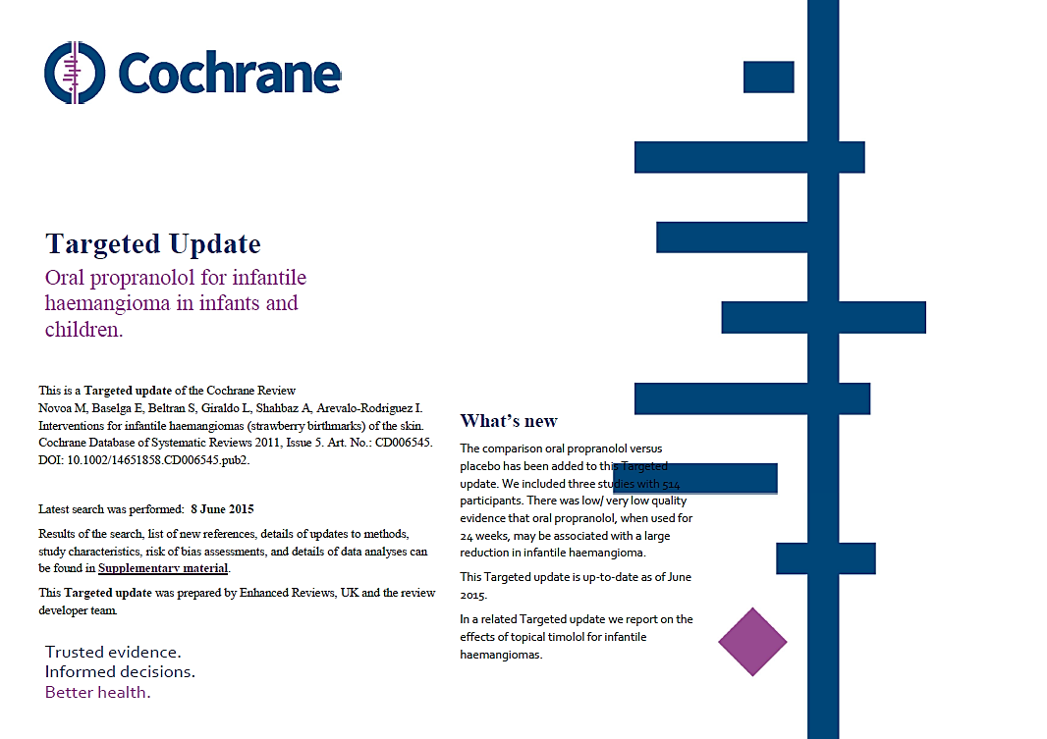
Notes:
There are the two final versions of the Targeted Update documents for the infantile haemangiomas review (one for ‘Oral Propranonol’, and one for ‘Topical timolol’). This is the final document that shows the amendments and what is new. The title is oral propranolol for IH in infants and children

Slide 25
Notes:
This is a resume of the disease, the objective is to assess the effects of oral propranolol compared to placebo for IH in infants and children.
It also contains the search methods as you can see , selection criteria that was ramdomised controlled trial, data collection and analysis, main results, implication and conclusion. And in this box are the studies that we included

Slide 26
Notes:
This is the summary of findings table that show the outcome like clearance of hemangioma, serious adverse events, relative risk and certainty of the evidence of each trial.

Slide 27
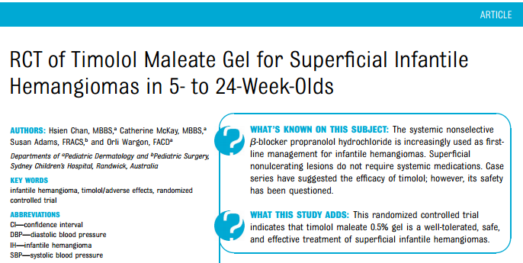
Selected Article
Chan H, Mckay C, Adams S, Wargon O. Pediatric 2013; 131 (6): e 1739-47
Notes:
After performing the literature search, 1 trial of topical timolol was selected out of the 20 we chose in the total search. This is RCT of timolol maleate gel for superficial infantile hemangioma from 5 to 24 week olds
Based on that article, the document was written. 6 ongoing studies were identified.

Slide 28
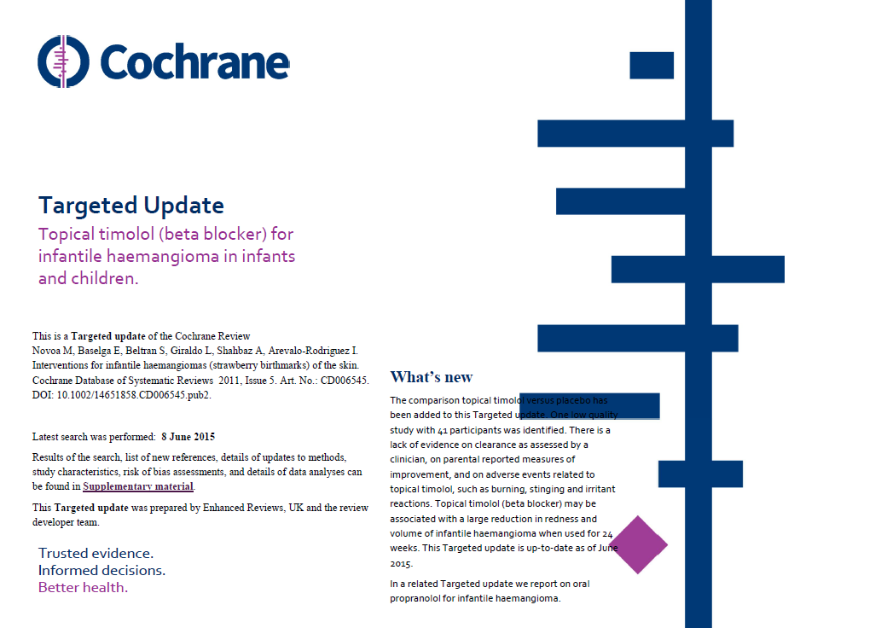
Notes:
And this is the final document of topical timolol that shows the same as Propranolol document, with the latest amendments and what is new. The title is topical timolol for IH in infants and children

Slide 29
Notes:
This a little resume of the disease, the objectives is to assess the effects of topical timolol compared to placebo for superficial IH
in infants and children. It also contains the search methods as you can see, selection criteria that was ramdomised controlled trial, data collection and analysis, main results, implication and conclusion. And in this box, are the studies we included.

Slide 30
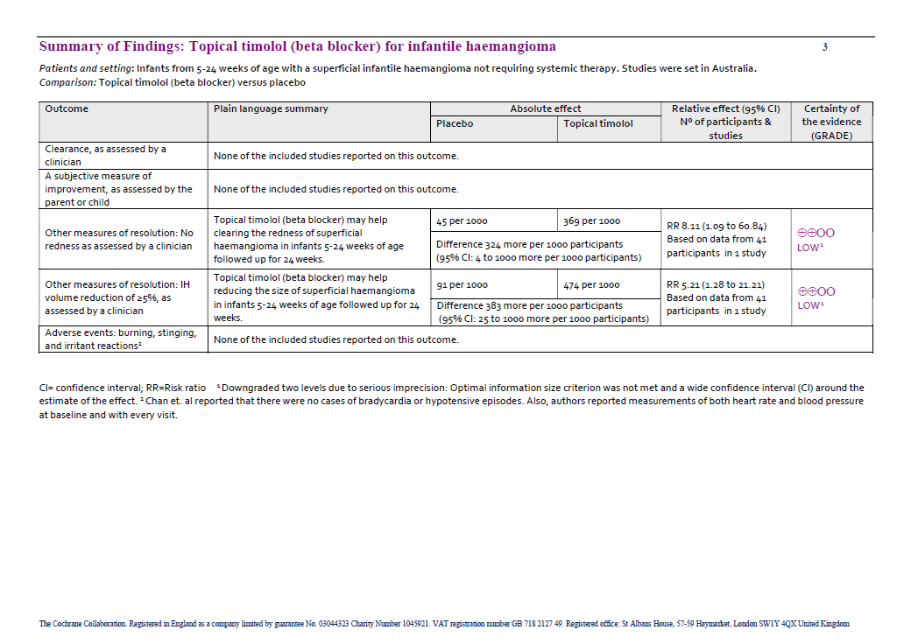
Notes:
This is the summary of findings table that show the outcome like clearance of hemangioma, serious adverse events, risk ratio and certainty of the evidence of this trial.

Slide 31
Beta-blockers: how intervention works?
The proposed mechanism of action of propranolol includes:
Rapid vasoconstriction: which corresponds to the color change from pink to violaceous typically seen in the first 1 to 2 days of therapy.
Inhibition of angiogenesis: by downregulation of proangiogenic growth factors, vascular endothelial growth factor, basic fibroblast growth factor, and matrix metalloproteinases 2 and 9 seems to correspond to growth arrest.
Acceleration of apoptosis of endothelial cells: known to occur in natural involution, has been proposed to result in the stimulation of IH regression.
Notes:
It ‘s important to know how beta blockers work in the regression of hemangiomas.
The proposed mechanism of action includes a rapid vasoconstriction, inhibition of angiogenesis, and acceleration of apoptosis of endothelial cells

Slide 32
K. Püttgen, MD; Diagnosis and Management of Infantile Hemangiomas; Pediatr Clin N Am 61 (2014) 383–402.
Notes:
Here is a baby with IH before and after propranolol 5 months later.

Slide 33
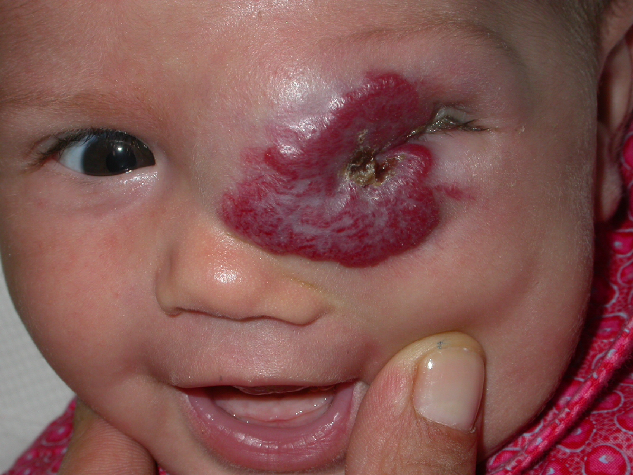

Age: 2 months
Notes:
She is a 2 months old baby that had a hemangioma in a high risk area, that responded successfully with oral propranolol

Slide 34
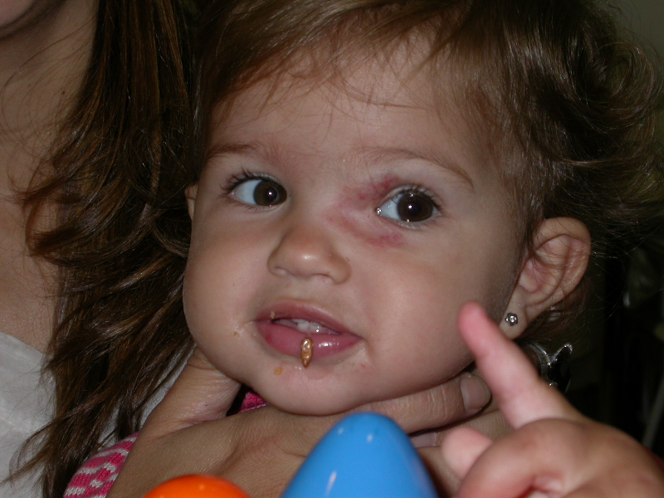
Age: 9 months
Dr. Eulalia Baselga
Notes:
She is the same baby 5 months later with treatment

Slide 35
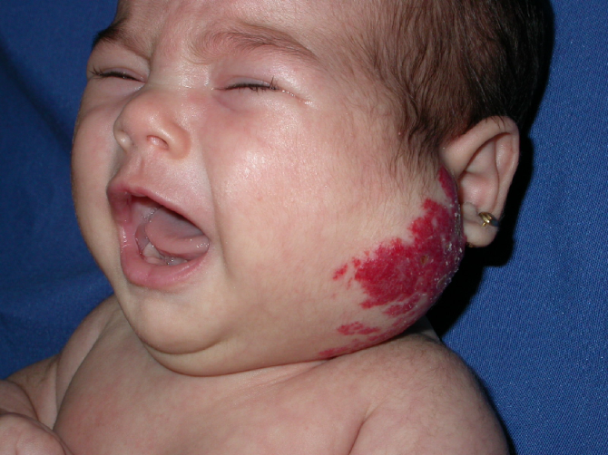
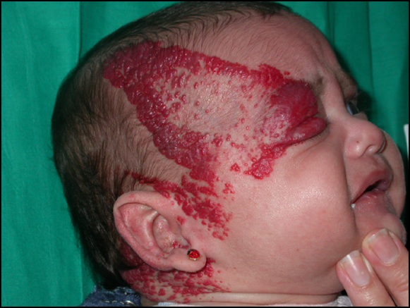
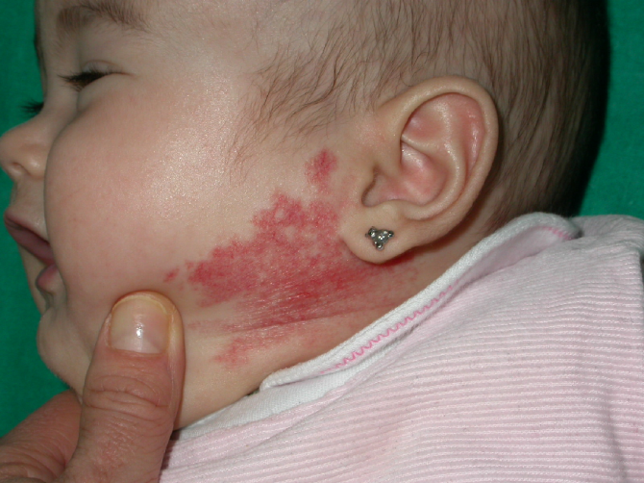
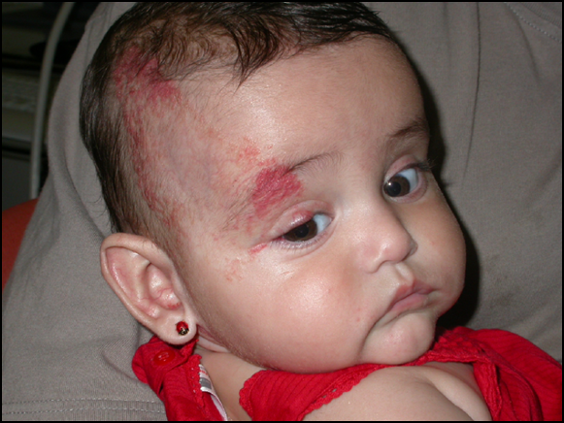
Notes:
There are 2 more examples of babies with deep and superficial hemangiomas

Slide 36
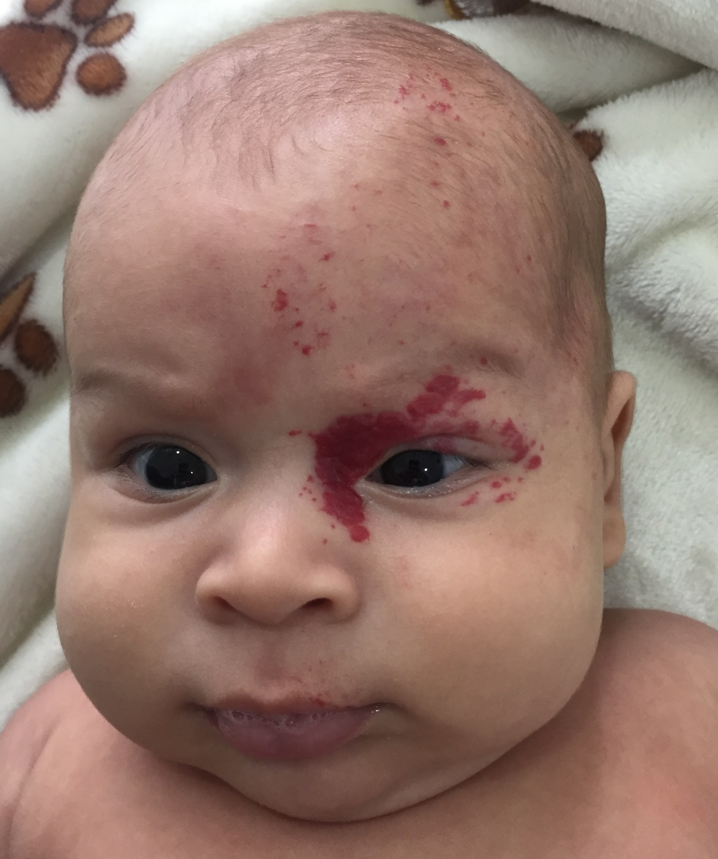
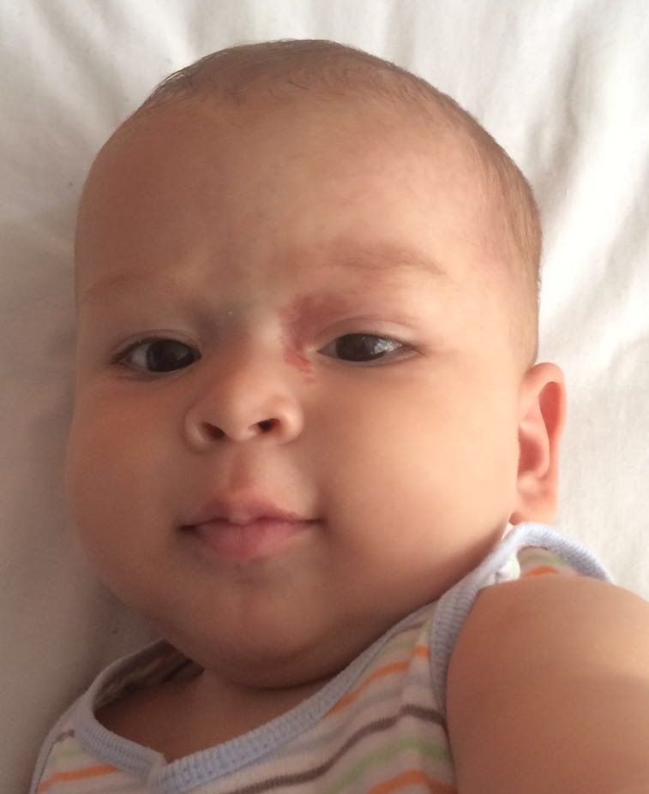
3 months
8 months
Notes:
Other patient with segmentary hemangioma that responded successfully with propranolol

Slide 37
B-blockers: how intervention works?
Topical Timolol
0.5% gel
Is an alternative for smaller, cosmetically sensitive lesions
Can be used as an adjunct to systemic therapy in some cases
To prevent rebound growth
Notes:
Topical timolol is used in 0.5% gel and is an alternative for smaller, cosmetically sensitive lesions
Can be used as an adjunct to systemic therapy in some cases and to prevent rebound growth

Slide 38
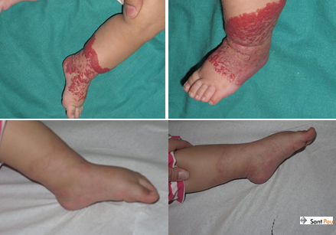
Dr. Eulalia Baselga
Notes:
And finally , this is a boy with superficial hemangiomas who was treated with topical timolol for 6 months

Slide 39
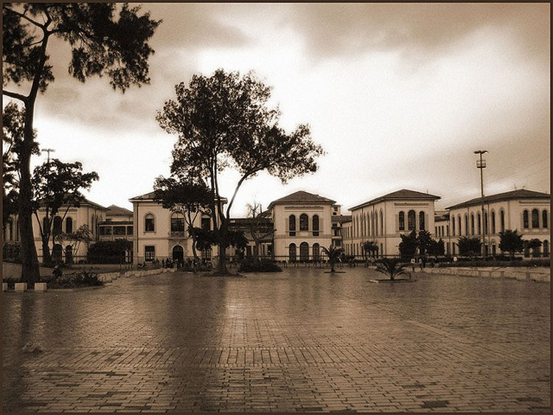
Notes:
Thank you for your time today, I hope you have found my presentation useful and interesting, now I would like to show you a few photos, and a quick video of Colombia.

Slide 40
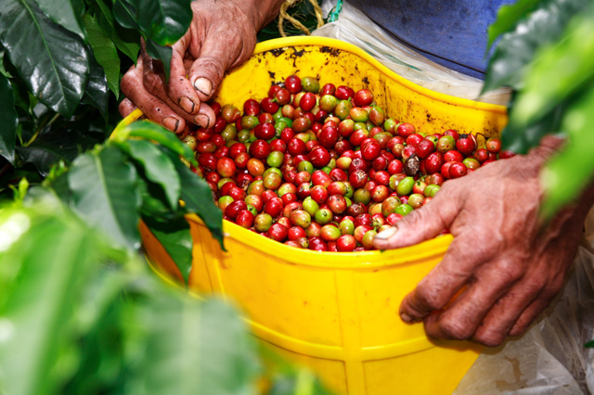


Thank you !!
Notes:
Thank you for your time. I would like to open any questions you may have, if possible could you kindly write them on the paper provided and I will answer them for you.

