Slide 1


Peter Smart
Consumer Referee
16 January 2016

Slide 2
Consumers and research
Personal credentials
Suffered multiple episodes of cellulitis
Member of Centre of Evidence Based Dermatology patient panel
Member of cellulitis PSP steering group
Reviewer of Cochrane cellulitis-related protocols and reviews
Cited co-author in several papers on cellulitis
Participant in planning Cochrane Colloquium 2018

Slide 3
Consumers and research
A personal perspective
Why should patients be involved in systematic reviews?
They know what it is like to suffer from ‘the disease’ (whatever ‘the disease’ is, in my case cellulitis)
They might have some idea of the treatment that suits them best – and what does not (especially how to prevent recurrent episodes)
They have the ultimate interest in the outcome of the research

Slide 4
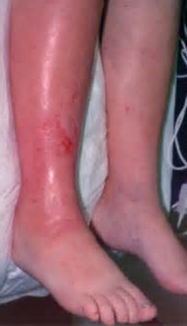
Consumers and research
A personal perspective - cellulitis
What is cellulitis?
  acute bacterial infection of deeper layers of the skin and underlying tissue
  can affect anyone, and totally without warning
  infection develops suddenly, can spread through the body quickly, and severe cases can be life-threatening
  episodes typically last two weeks or longer
  about 1/3 of sufferers have repeat episodes
  many sufferers have never heard of cellulitis until they are diagnosed with it

Slide 5

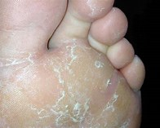
Consumers and research
A personal perspective - cellulitis
What causes cellulitis?
  most common causative organism is group A streptococcus
But what causes the causes of cellulitis?
  athlete’s foot, other breaks in the skin, cut, graze, eczema
  The million Euro question

Slide 6
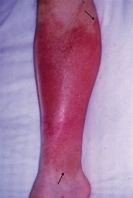
Consumers and research
A personal perspective - cellulitis
How is cellulitis diagnosed?
  typical features – red, painful, hot, swollen and tender skin
  fever, malaise, nausea, shivering, rigors
Differential diagnosis – what else might it be?
  DVT, gout, septic arthritis, …

Slide 7
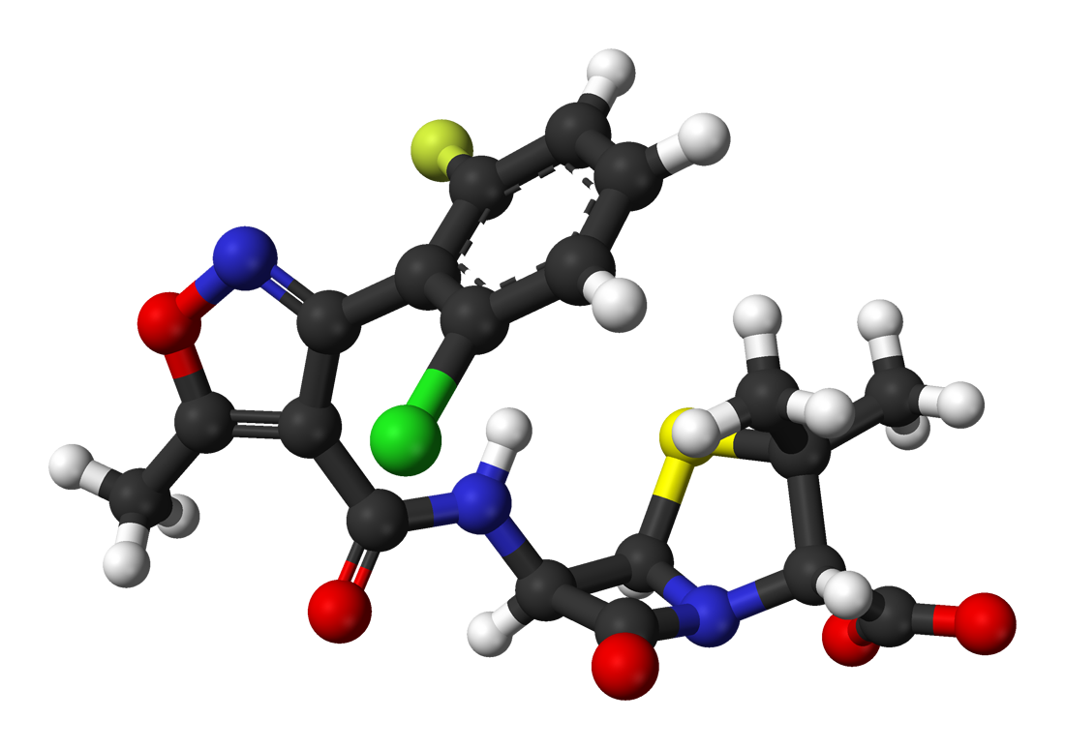
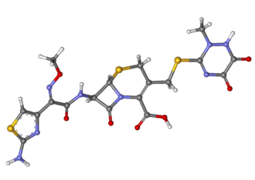
Consumers and research
A personal perspective - cellulitis
How is cellulitis treated?
  high dose oral antibiotics
  high dose intravenous antibiotics
  at home or in hospital

Slide 8

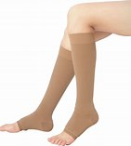
Consumers and research
A personal perspective - cellulitis
Can repeat episodes be prevented?
  long-term low dose antibiotics
  non-antibiotic interventions, such as use of emollients and/or wearing of compression socks/stockings/ garments/bandages

Slide 9
Consumers and research
Why involve patients in research?
At the planning stage
Project steering group
Reviewer – protocol and research papers
Post-publication
  To advise on the perceived relevance and scope of the proposed research to the needs/interests of patients
  To identify any mechanisms for wider patient input
  To help avoid ‘unintended consequences’

Slide 10
Consumers and research
Why involve patients in research?
At the planning stage
Project steering group
Reviewer – protocol and research papers
Post-publication
  To offer a continuing input on patient-related issues throughout the research period
  Example: the CEBD-James Lind Alliance Priority Setting Partnerships
    Four patients on the cellulitis PSP Steering Group plus additional patients ar final workshop
    Five patients on eczema PSP Steering Group

Slide 11
Consumers and research
Why involve patients in research?
At the planning stage
Project steering group
Reviewer – protocol and research papers
Post-publication
  Feedback on whether the draft (or at least the plain language summary) is written in a patient-friendly manner
  Offer advice on drafting, especially where English is not the first language of the authors

Slide 12
Consumers and research
Why involve patients in research?
At the planning stage
Project steering group
Reviewer – protocol and research papers
Post-publication
  Especially in relation to any patient guides or handbooks or feedback that are proposed as one of the outcomes

Slide 13
Consumers and research
A personal perspective
Importance of patient training days
  Example – CEBD patient panel annual training day
  To ensure patient representatives are up to date on current developments, can contribute to PSPs and respond to requests for participation in research programmes

Slide 14
#PatientsIncluded
The international dimension
The 2018 Cochrane Colloquium in Edinburgh
Emphasis on the role of patients to Cochrane research
Looking at innovative ways of involving patients
Seeking joint presentations of researchers/practitioners and patients

Slide 15
Thank you
Dank je
Danke schön
Merci beaucoup
谢谢
ありがとうございました

